Slide 1
The IOF University Network

Slide 2
IOF and its Committees

Slide 3
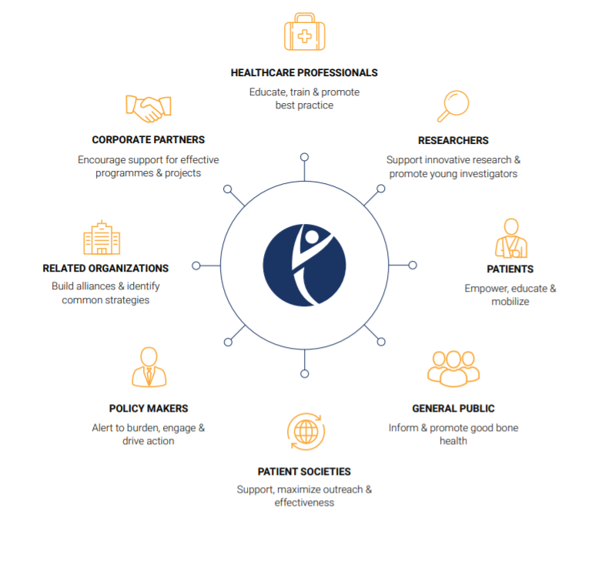
VISION AND MISSION OF IOF
Vision
Our vision is a world without fragility fractures, in which healthy mobility is a reality for all
MISSION
To promote bone and musculoskeletal health as a worldwide priority.

Slide 4
The IOF Committees
An extensive network of key stakeholders
The IOF Committee of National Societies
A comprehensive network of patients’ and scientific organizations showing interest in advocating on bone health, promoting patient empowerment, and supporting research and education of health professionals worldwide
The IOF Committee of Scientific Advisors
The medical and scientific community of IOF. It's comprised of 162 global experts in the field of osteoporosis and musculoskeletal health. The CSA mission entails advising the Board in all scientific matters related to IOF’s work, further the clinical and research objectives of IOF, support national policy changes and provide recommendations for Best Practice in the fields.
The IOF Committee of Corporate Advisors
A unique forum composed of a wide and diversified range of companies committed to promoting bone health and improving osteoporosis and fracture prevention and care. Members of the Committee include leading companies in pharmaceuticals, orthopaedic/medical devices, and the food and nutrition industries.

Slide 5
269 patient & medical societies in 148 countries
representing 88% of the global population

Slide 6
The IOF University Network
Multidisciplinary collaboration worldwide

Slide 7
Scope and Objectives
Expand the IOF Network by integrating renowned Universities worldwide
Share knowledge on the latest developments and challenges in the bone field
Develop research projects to encourage young scientists and young HCPs to pursue studies in the field of osteoporosis and musculoskeletal diseases
Universities will be Allied Members of the IOF Committee of National Societies
Support the next generation of KOLs of in the field of osteoporosis and musculoskeletal diseases
Elaborate programmes for young scientists and health professionals collectively

Slide 8
Membership Benefits
Access to educational and scientific resources & materials
Access to a global network of experts
Endorsement of musculoskeletal and bone health meetings and publications
Access to advocacy resources to support organization of osteoporosis awareness activities
Opportunity for collaboration on research projects
Free registrations to WCO-IOF-ESCEO Congress and IOF Regional Events

Slide 9
How to join
By joining your University will actively take part in the global voice dedicated to osteoporosis, fragility fractures and musculoskeletal disorders around the world.
Your institution will be an Allied Member of the Committee of National Societies
Members in the IOF network represent a broad range of related interests.
Free membership
Fill out the IOF University Network Application Form
Send it to lorelei.demullier@osteoporosis.foundation

Slide 10
IOF resources and flagship operations

Slide 11
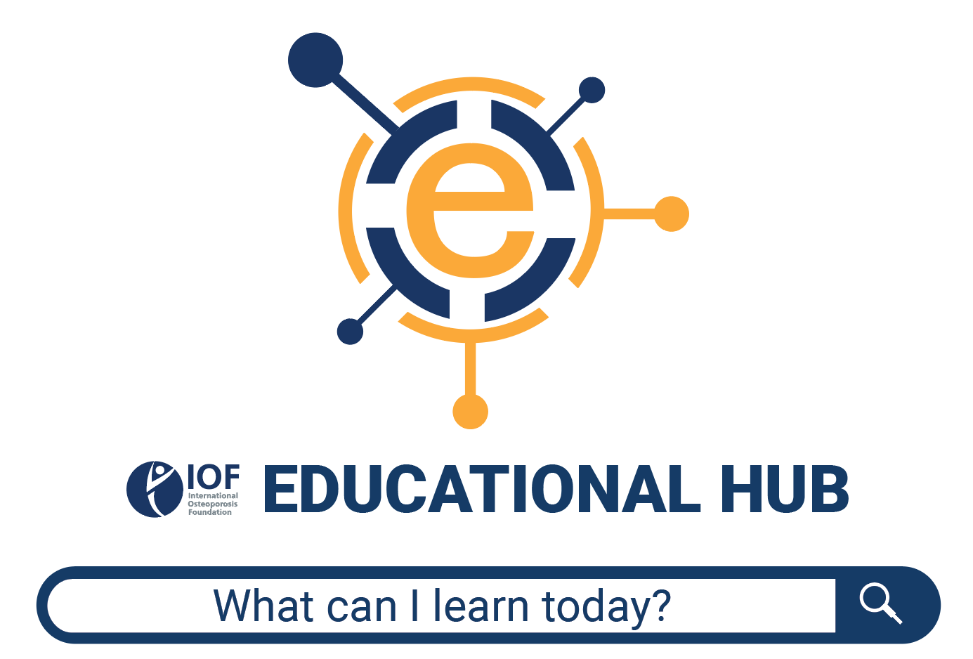
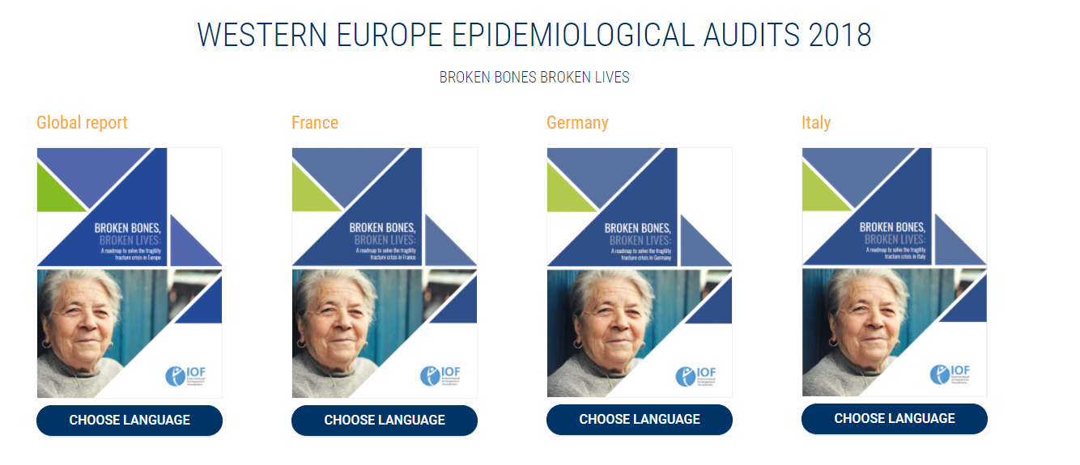
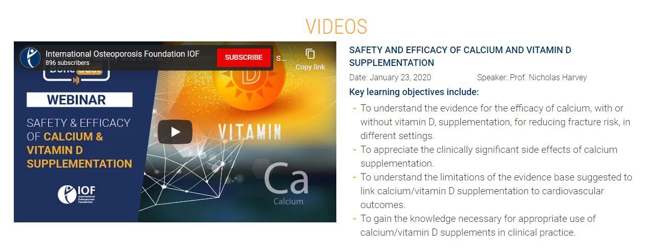
Educational Hub
ALL IOF ESSENTIALS TOOLS AND RESOURCES DIVIDED BY TOPICS & MATERIALS

Slide 12
IOF Scientific & Education Activities and Resources

Slide 13
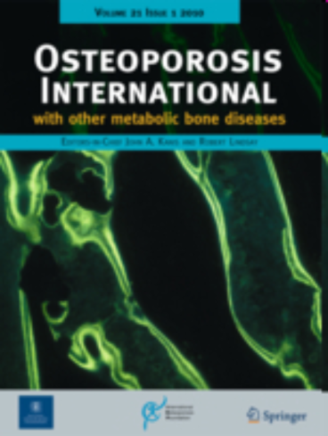
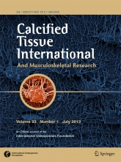
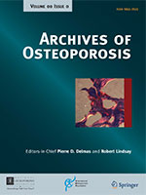
IOF Scientific Journals
EDITORS-IN-CHIEF
John A Kanis
Felicia Cosman
IF
3.591 in 2016
3.856 in 2017
3.819 in 2018
3.864 in 2019
3.917 in 5-year
EDITORS-IN-CHIEF
René Rizzoli
Stuart H Ralston
IF
3.124 in 2016
3.293 in 2017
3.265 in 2018
3.423 in 2019
3.437 in 5-year
EDITORS-IN-CHIEF
John A Kanis
Felicia Cosman
IF
1.960 in 2016
2.382 in 2017
2.469 in 2018
2.017 in 2019
2.311 in 5-year
OI ranked 44th of 143 journals in the category Endocrinology & Metabolism, CTI 59th, AO 115th
AO ranked 38th of 82 journals in the category Orthopedics

Slide 14
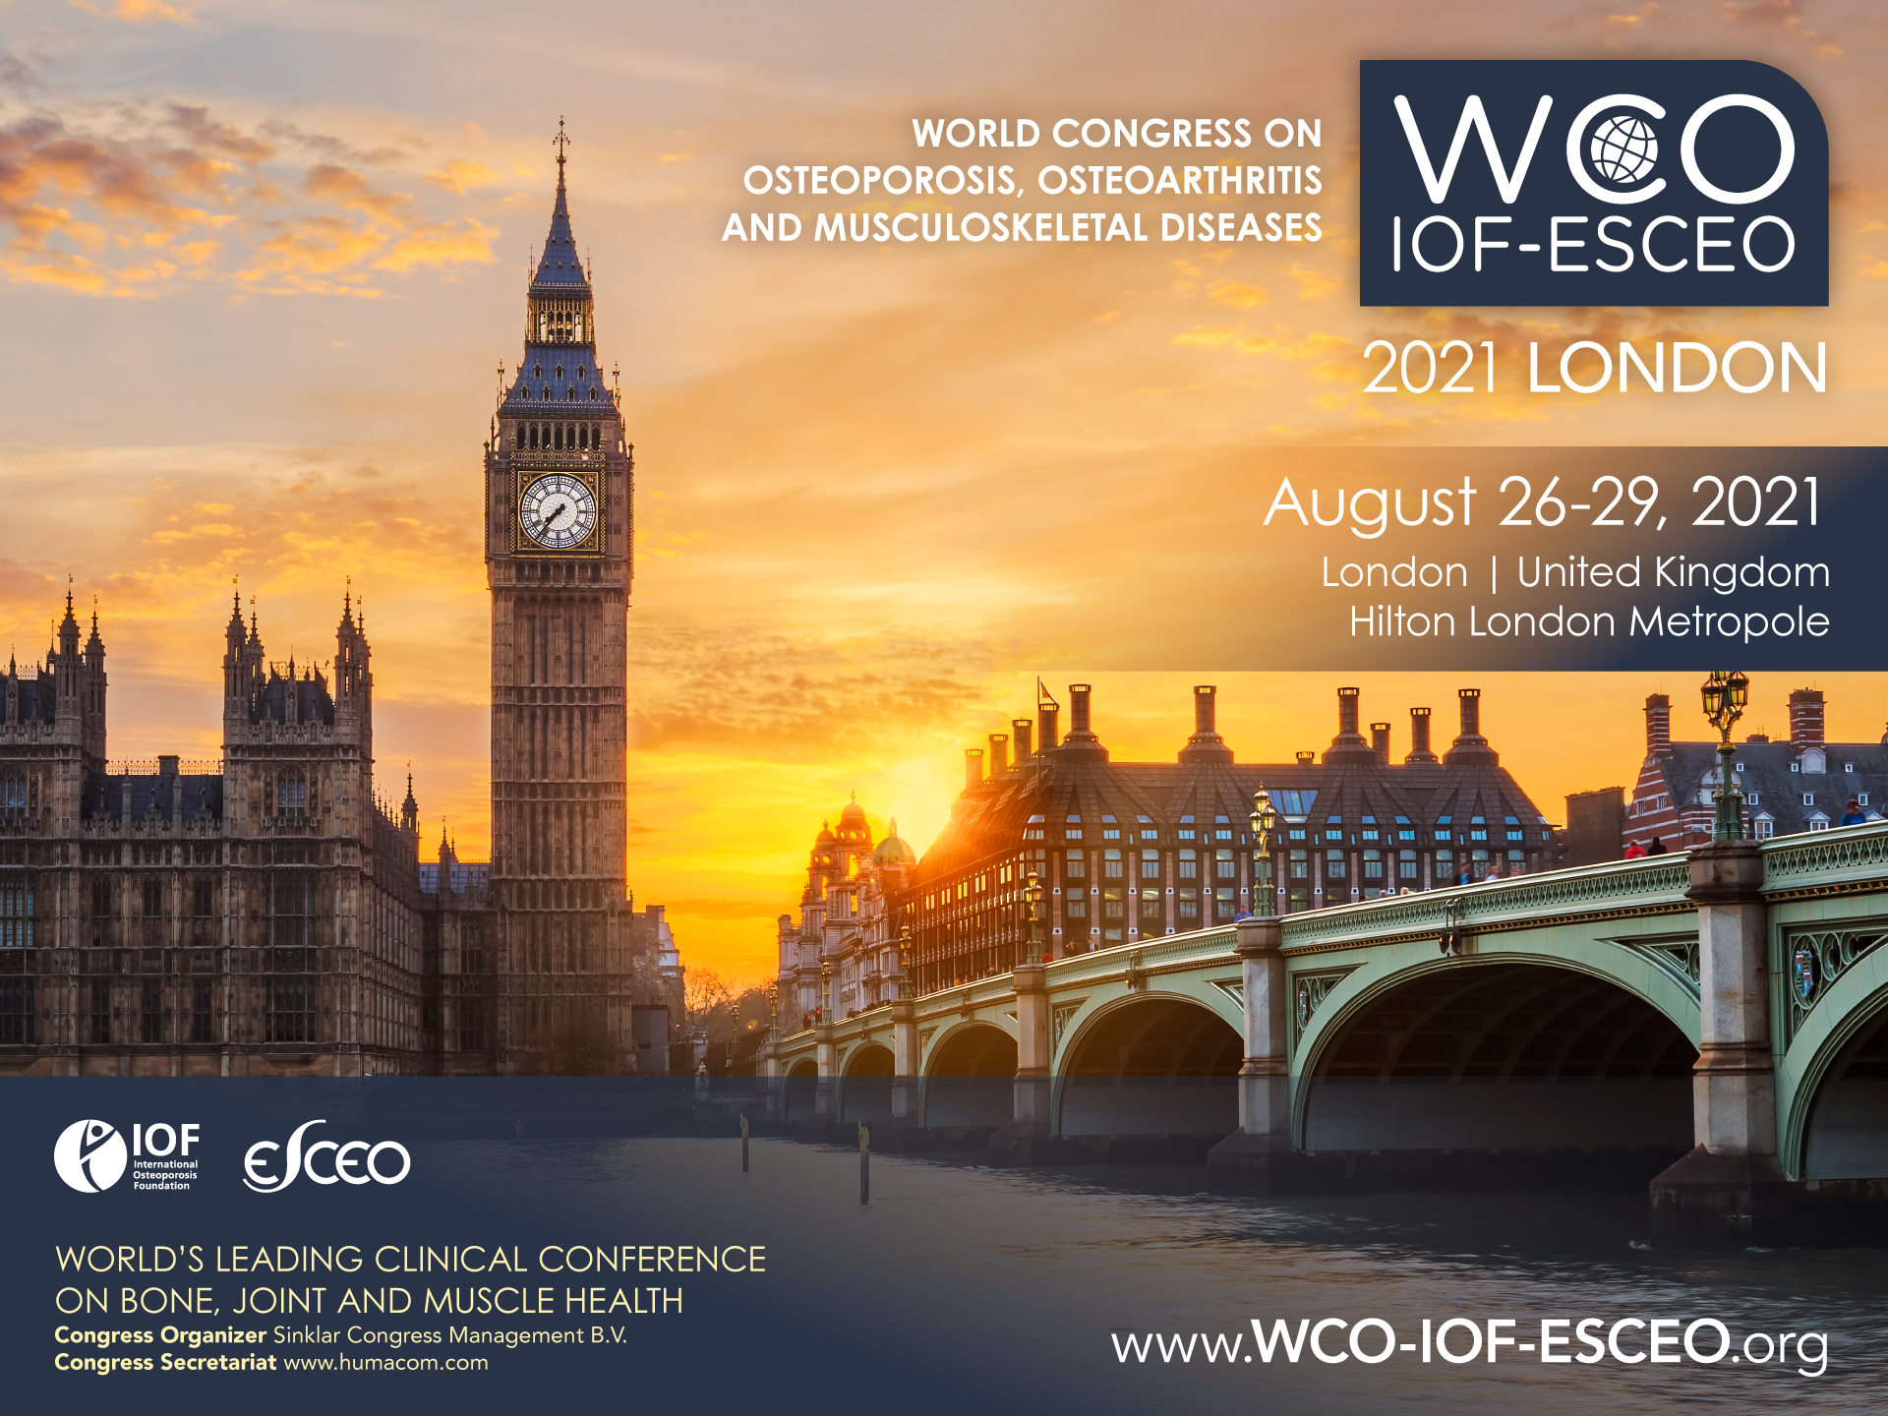
IOF Events
WCO-IOF-ESCEO Annual congress
IOF Regional Conference

Slide 15
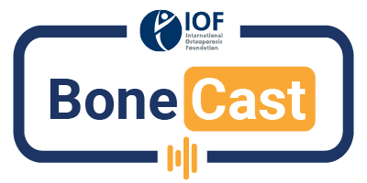
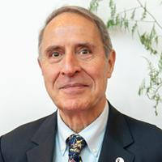
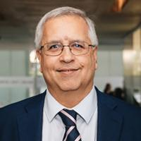
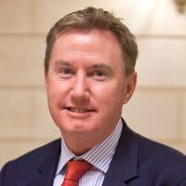
BoneCast webinar
HOSTED BY IOF CSA MEMBERS
Key experts in the field
A LARGE VARIETY OF TOPICS
Ca & VitD supplementation, hypoparathyroidism, GIOP, FLS, nutrition…
René Rizzoli
Cyrus Cooper
Peter Ebeling
Nicholas Harvey
Serge Ferrari
Kassim Javaid
Thierry Thomas
Nancy Lane
Gustavo Duque
Aliya Khan

Slide 16
Osteoporosis Essentials Course
What is the Osteoporosis Essentials Course?
A joint course proposed by the International Society for Clinical Densitometry and IOF
The course provides for a comprehensive training on the clinical management of osteoporosis as well as a separate track for technicians.
A certificate of achievement is delivered upon success at the final examination.
Who can benefit from an Osteoporosis Essentials Course?
Members of the IOF Network are entitled to be the organizer of an Osteoporosis Essentials Course
More information on the Osteoporosis Essentials Course can be found here

Slide 17
IOF Advocacy Activities and Resources

Slide 18
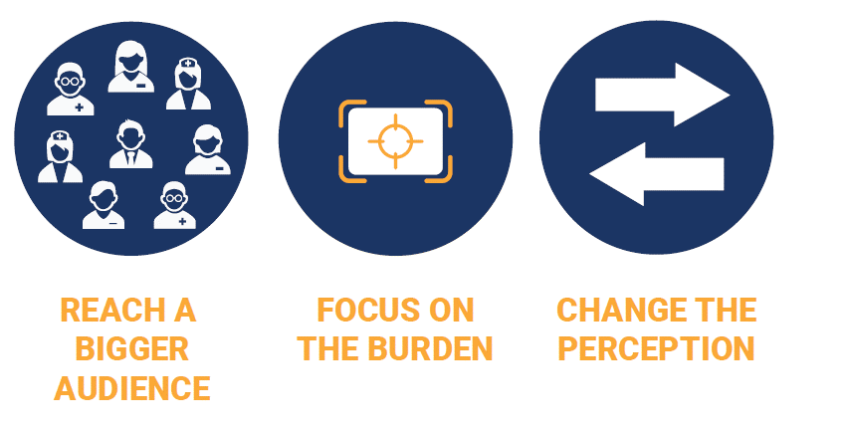
Enhancing the University’s visibility with promotion of events organised for WOD on the WOD Map of Events

Slide 19
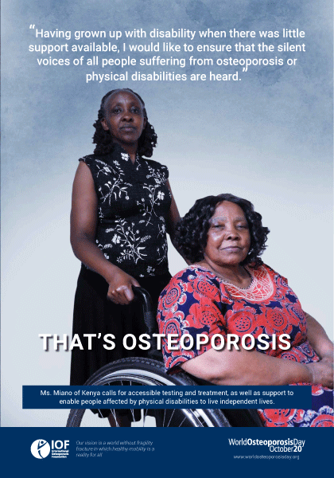
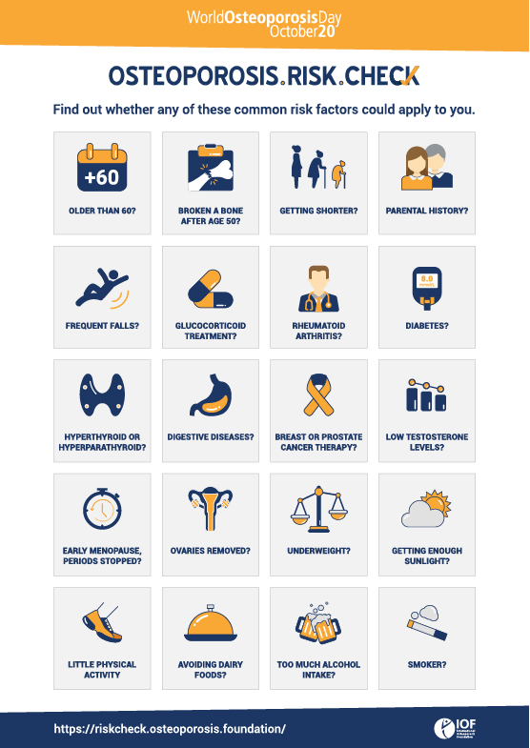
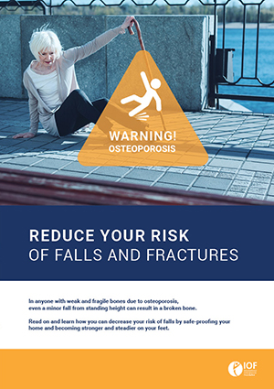
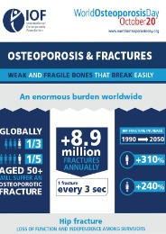
World Osteoporosis Day
Resources and materials provided by IOF
Patient Gallery with stories and posters
Posters
Patient brochure
Infographics & Factsheets

Slide 20
RISK CHECK
MAIN GOALS:
Raise awareness about the osteoporosis risk factors
Access more patients at risk
Drive traffic to the IOF and WOD website
RESOURCES PRODUCED:
Online Risk Check version
Printable Risk Check version
Infographic with a summary of the risk factors
All translated
into 36 languages
Link: Could you be at risk of broken bones due to osteoporosis? | International Osteoporosis Foundation

Slide 21
Global Patient Charter which calls for 4 key patient rights
Right to be diagnosed
Right to support for the patient’s family
Right to adequate care
Raise the patient’s voice

Slide 22
WOD is an ideal occasion to draw attention to the burden of osteoporosis through the IOF Global Patient Charter
Circulate petition at your event
Use tablets and computers at your event to invite the public to:
Sign the Charter online
Take the Osteoporosis Risk Check online
Online resources (website: http://globalpatientcharter.iofbonehealth.org/ )
GPC Factsheet
GPC Infographics

Slide 23
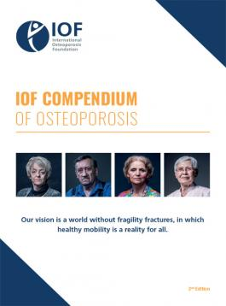
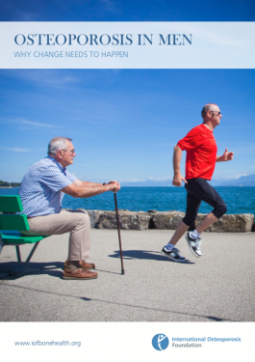
Thematic reports

Slide 24
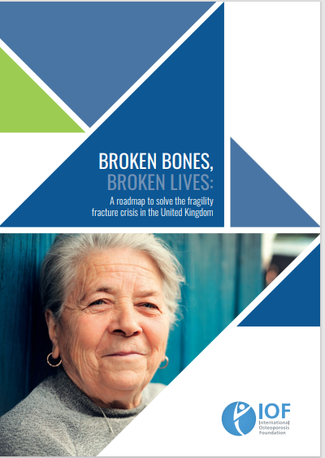
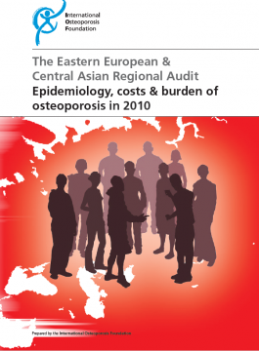
Regional Audits

