Slide 1
World Osteoporosis Day Survey 2023
5 countries – 5 languages – women aged 60+

Slide 2
Summary
September 6 – October 6, 2023
5 Facebook posts in national languages were disseminated in 5 countries to women age 60+ promoting the survey
  United Kingdom (English) – reached 141.4K people
  Japan (Japanese) - reached 252.6K people
  Brazil (Portuguese) - reached 1.4M people
  Spain (Spanish) - reached 651.6K people
  South Korea (Korean) - reached 137.3K people
Overall, the campaign has reached 2’580’000+ women and was clicked on over 80’000 times
5 separate surveys were issued (1 per country)
Survey results will be posted on a dedicated page on www.osteoporosis.foundation
Surveys started:
10’687
Surveys submitted:
7’139
Average completion rate
60.6%

Slide 3
Summary results
Q1: After the age of 50, did you break a bone after a minor fall or bump?
Q5: (for those who did not have fractures after the age of 50)
Has your doctor ever discussed bone health or
osteoporosis with you?

Slide 4
Summary results
Q3: After your break, were you given a diagnostic scan to assess for osteoporosis?
Q4: After your break, did you receive medication for osteoporosis?

Slide 5
Summary results
Q6: Spine fractures due to osteoporosis often remain undiagnosed. Have you noticed any of these symptoms?
(multiple answers possible)

Slide 6
Key Findings
On average, almost half (43%) of the women surveyed stated that they had broken a bone following a minor fall or bump after the age of fifty. The percentage was highest in Japan (73.3%) and the UK (60.9%), and lowest in Brazil (21.6%).
Evaluation and treatment were clearly inadequate as an average of 32.7% did not have a diagnostic scan and 45% did not receive any kind of treatment for osteoporosis following their fracture.
The treatment gap was highest in Spain where 58.4% stated that they had not received treatment, followed by Brazil (52.4%).
Of the 57.16% of respondents who indicated they had not broken a bone, an average of 31.3% stated that they had never discussed bone health or osteoporosis with their doctors. This was highest in the UK (51.1%) followed by Japan and Spain (each 31.3%).
Of those who had discussed bone health with their doctors, an average of 63% indicated that they had a diagnostic scan (ranging from 43.7 % in the UK to 72% in Brazil and South Korea) and an average of only 13% stated that they had discussed risk factors.
In all countries surveyed, wrist fractures were the most common type of fracture (average 33.1%) followed by spine fractures (average 20.1%).
Spinal fractures due to osteoporosis often remain undiagnosed and unrecognized. A high percentage of the women who said they had not broken a bone indicated that they were experiencing either back pain (average 49.4%) or height loss of more than 4 cm / 1 ½ inches (average 18.2%), with the latter ranging from 6.7% in Japan to 25.7% in Spain.

Slide 7
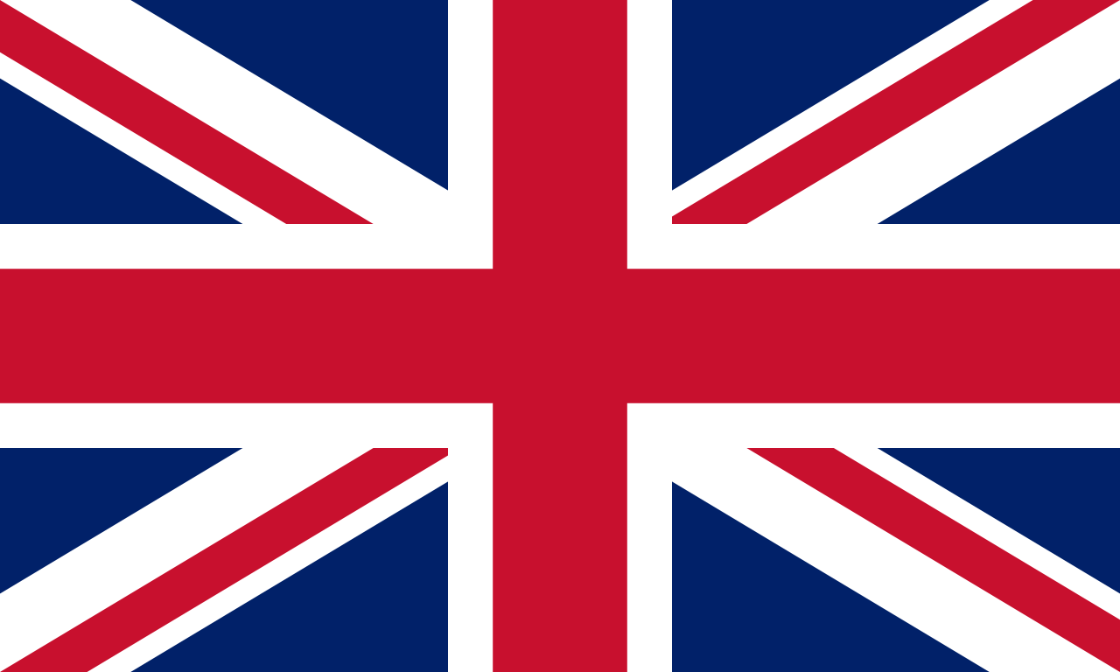
Survey in the United Kingdom
3’600 responses

Slide 8
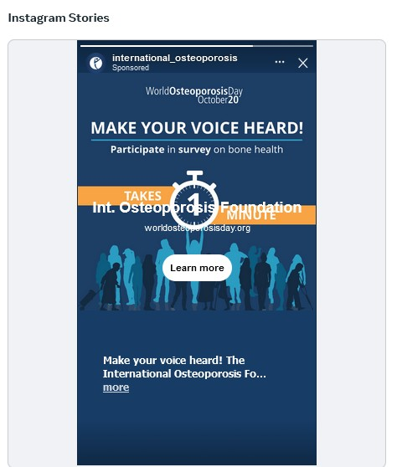

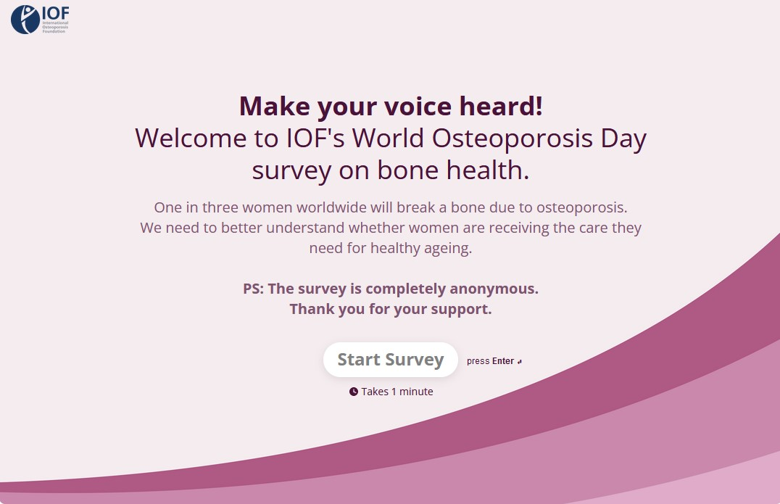
United Kingdom
Key stats
Facebook post
  Reached 141’400 women aged 60+
  6’134 of them clicked the link
  Over 90 comments, with women sharing their stories and starting conversations
Surveys started
4’475
Surveys submitted
3’600
Completion rate
80.4%

Slide 9
United Kingdom
Detailed results
Q1: After the age of 50, did you break a bone after a minor fall or bump?
3’600 out of 3’600 women answered this question
Yes (2’200 resp.)
60.9%
No (1’400 resp.)
39.1%%
Q2: Which bone(s) did you break:
1’332 out of 2’200 women that said yes, answered this question (multiple answers possible)
42.8%
40.8%
17.7%
11.6%
9.6%
8.8%

Slide 10
United Kingdom
Detailed results
Q3: After your break, were you given a diagnostic scan to assess for osteoporosis?
1’385 out of 2’200 women that said yes to the first question, answered this question
Yes (862 resp.)
62.2%
No (523 resp.)
37.8%
Q4: After your break, did you receive medication for osteoporosis?
1’409 out of 2’200 women that said yes to the first question, answered this question
If yes, what medication(s) were you prescribed:
Yes (802 resp.)
56.9%
No (607 resp.)
43.1%

Slide 11
United Kingdom
1’400 women, who replied ‘NO’ to the 1st question:
Q5: Has your doctor ever discussed bone health or osteoporosis with you?
2’143 responses by 1’400 women answered this question (with multiple choice)
256 resp.
936 resp.
1’1K resp.

Slide 12
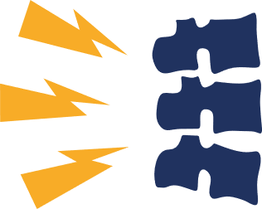
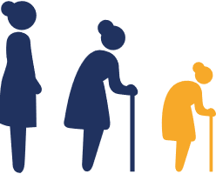

United Kingdom
1’400 women, who replied ‘NO’ to the 1st question:
Q6: Spine fractures due to osteoporosis often remain undiagnosed. Have you noticed any of these symptoms?
2’144 responses by 1’400 people answered this question (with multiple choice)
Back Pain (1’100 resp.)
51.3%
Height Loss (of 4 cm/ 1.5 inches or more) (514 resp.)
24%
Neither (902 resp.)
42.1%

Slide 13
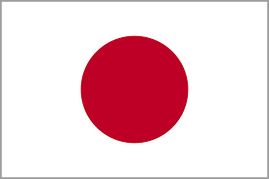
Survey in Japan
1’116 responses

Slide 14
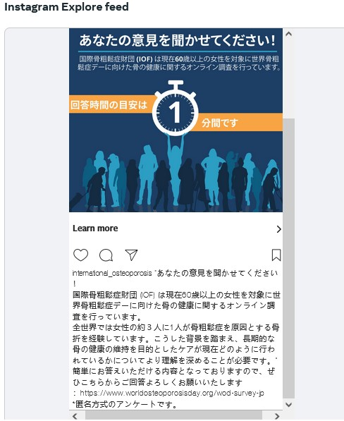
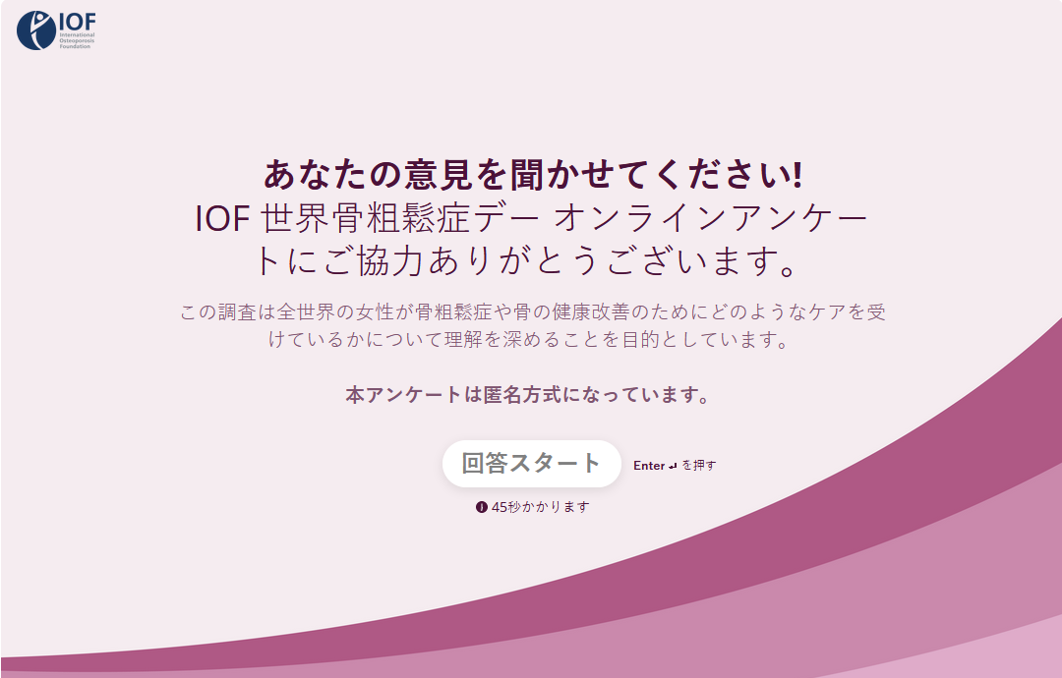
Japan
Key stats
Facebook post
  Reached 252’600 women
  5’216 of them clicked the link
  Over 550 post reactions with women sharing their stories and starting conversations
Surveys started
1’841
Surveys submitted
1’116
Completion rate
60%

Slide 15
Japan
Detailed results
Q1: After the age of 50, did you break a bone after a minor fall or bump?
1’116 out of 1’116 women answered this question
Yes (818 resp.)
73.3%
No (298 resp.)
26.7%
Q2: Which bone(s) did you break:
232 out of 1’116 women that said yes, answered this question (multiple answers possible)
35.3%
36.2%
21.1%
15.9%
8.6%
8.8%

Slide 16
Japan
Detailed Results
Q3: After your break, were you given a diagnostic scan to assess for osteoporosis?
293 out of 1’116 women that said yes to the first question, answered this question
Yes (197 resp.)
67.2%
No (96 resp.)
32.8%
Q4: After your break, did you receive medication for osteoporosis?
298 out of 1’116 women that said yes to the first question, answered this question
If yes, what medication(s) were you prescribed:
Yes (172 resp.)
57.7%
No (126 resp.)
42.3%
*Categorised as prescription medication

Slide 17
Japan
298 women, who replied ‘NO’ to the 1st question:
Q5: Has your doctor ever discussed bone health or osteoporosis with you?
321 responses by 298 answered this question (with multiple choice)
34 resp.
194 resp.
93 resp.

Slide 18
Japan
298 women, who replied ‘NO’ to the 1st question:
Q6: Spine fractures due to osteoporosis often remain undiagnosed. Have you noticed any of these symptoms?
306 responses by 298 women answered this question (with multiple choice)
Back Pain (79 resp.)
26.8%
Height Loss (of 4 cm/ 1.5 inches or more) (19 resp.)
6.7%
Neither (208 resp.)
70.3%

Slide 19
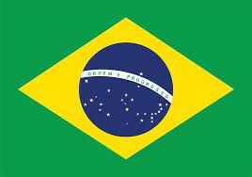
Survey in Brazil
1’155 responses

Slide 20
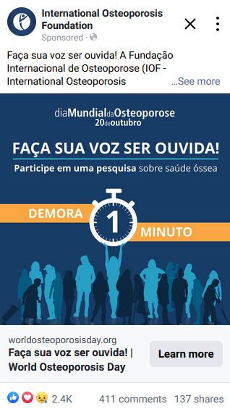
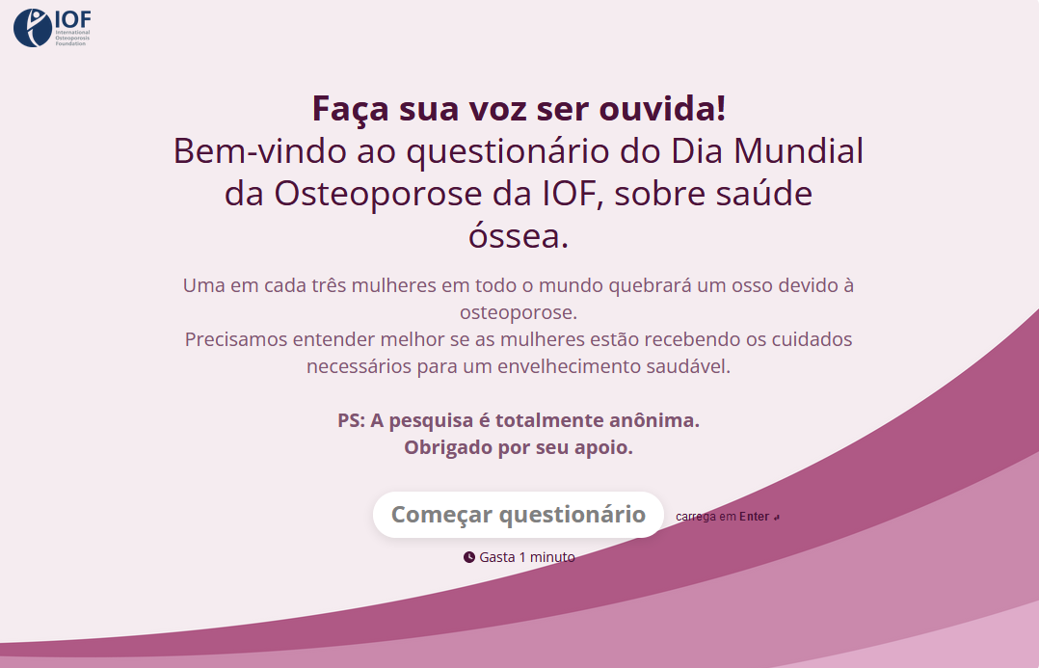
Brazil
Key stats
Facebook post
  Reached over 1’580’530 women aged 60+
  48’168 of them clicked the link
  Over 334 comments, with women sharing their stories and starting conversations
Surveys started
2’230
Surveys submitted
1’155
Completion rate
51.8%

Slide 21
Brazil
Detailed results
Q1: After the age of 50, did you break a bone after a minor fall or bump?
1’155 out of 1’155women answered this question
Yes (250 resp.)
21.6%
No (905 resp.)
78.4%
Q2: Which bone(s) did you break:
227 out of 250 women that said yes, answered this question (multiple answers possible)
36.1%
37.9%
18.1%
15.9%
12.3%
6.6%

Slide 22
Brazil
Detailed results
Q3: After your break, were you given a diagnostic scan to assess for osteoporosis?
240 out of 250 women that said yes to the first question, answered this question
Yes (146 resp.)
60.8%
No (94 resp.)
39.2%
Q4: After your break, did you receive medication for osteoporosis?
250 out of 250 women that said yes to the first question, answered this question
If yes, what medication(s) were you prescribed:
Yes (119 resp.)
47.6%
No (131 resp.)
52.4%

Slide 23
Brazil
905 women, who replied ‘NO’ to the 1st question:
Q5: Has your doctor ever discussed bone health or osteoporosis with you?
949 responses by 905 women answered this question (with multiple choice)
159 resp.
613 resp.
177 resp.

Slide 24
Brazil
905 women, who replied ‘NO’ to the 1st question:
Q6: Spine fractures due to osteoporosis often remain undiagnosed. Have you noticed any of these symptoms?
985 responses by 905 people answered this question (with multiple choice)
Back Pain (512 resp.)
58.6%
Height Loss (of 4 cm/ 1.5 inches or more) (197 resp.)
22.6%
Neither (276 resp.)
31.6%

Slide 25
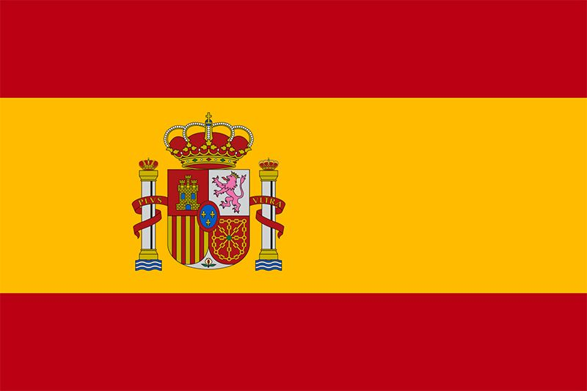
Survey in Spain
1’067 responses

Slide 26
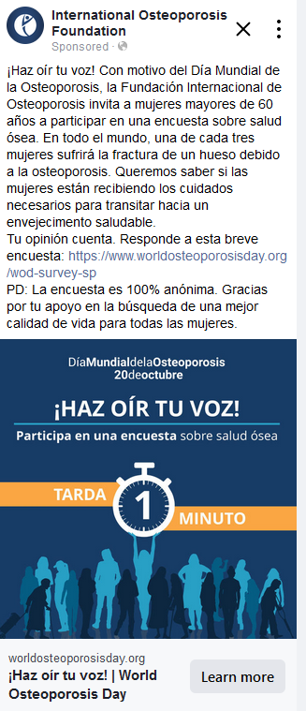
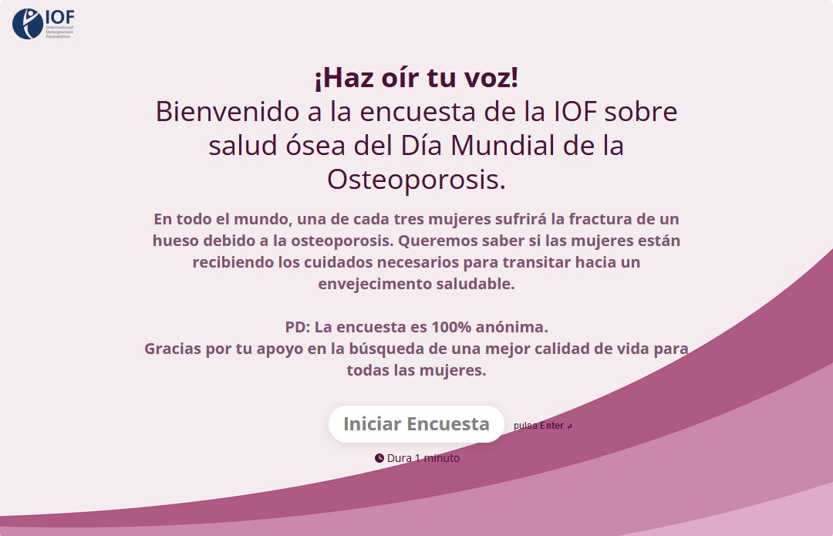
Spain
Key stats
Facebook post
  Reached 700’747 women aged 60+
  21’082 of them clicked the link
  Over 170 comments, with women sharing their stories and starting conversations
Surveys started
1’704
Surveys submitted
1’067
Completion rate
62.6%

Slide 27
Spain
Detailed results
Q1: After the age of 50, did you break a bone after a minor fall or bump?
1’067 out of 1’067 women answered this question
Yes (368 resp.)
34.5%
No (699 resp.)
65.5%
Q2: Which bone(s) did you break:
340 out of 368 women that said yes, answered this question
35.3%
35%
30%
15.3%
9.1%
9.1%

Slide 28
Spain
Detailed results
Q3: After your break, were you given a diagnostic scan to assess for osteoporosis?
355 out of 368 women that said yes to the first question, answered this question
Yes (146 resp.)
60.8%
No (94 resp.)
39.2%
Q4: After your break, did you receive medication for osteoporosis?
368 out of 368 women that said yes to the first question, answered this question
If yes, what medication(s) were you prescribed:
Yes (153 resp.)
41.6%
No (215 resp.)
58.4%

Slide 29
Spain
699 women, who replied ‘NO’ to the 1st question:
Q5: Has your doctor ever discussed bone health or osteoporosis with you?
717 responses by 699 women answered this question (with multiple choice)
95 resp.
412 resp.
210 resp.

Slide 30
Spain
699 women, who replied ‘NO’ to the 1st question:
Q6: Spine fractures due to osteoporosis often remain undiagnosed. Have you noticed any of these symptoms?
784 responses by 699 people answered this question (with multiple choice)
Back Pain (413 resp.)
61.4%
Height Loss (of 4 cm/ 1.5 inches or more) (173 resp.)
25.7%
Neither (198 resp.)
29.4%

Slide 31
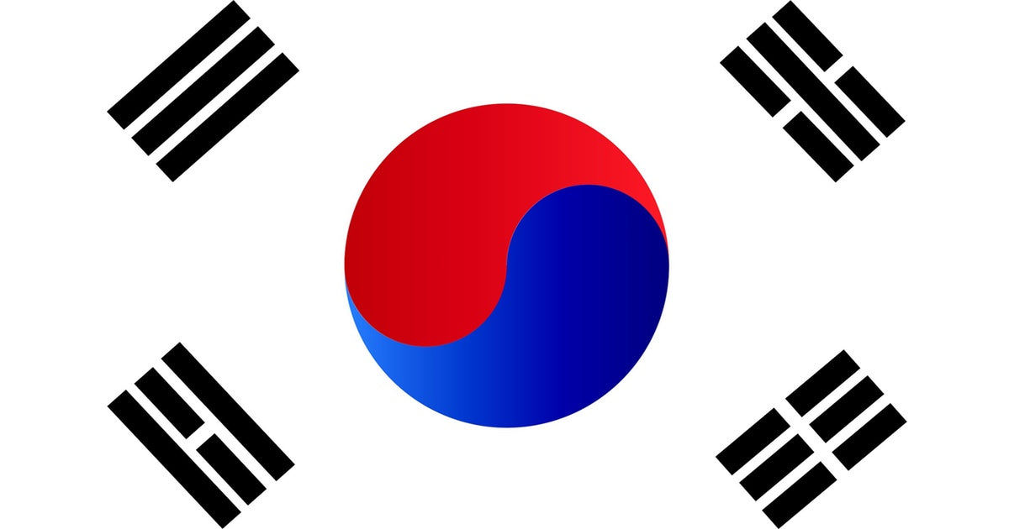
Survey in South Korea
201 responses

Slide 32
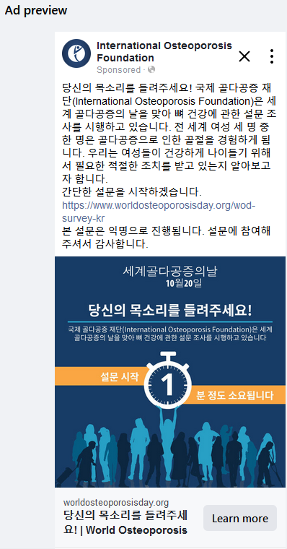
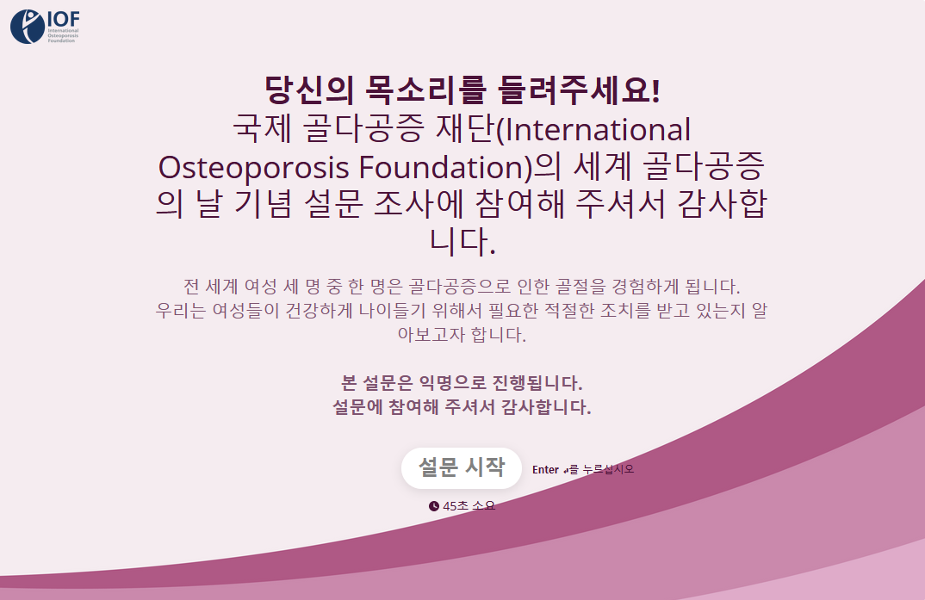
South Korea
Key stats
Facebook post
  Reached 147’440 women aged 60+
  9’757 of them clicked the link
  Over 386 reactions with women sharing their stories and starting conversations
Surveys started
417
Surveys submitted
201
Completion rate
48.2%

Slide 33
South Korea
Detailed results
Q1: After the age of 50, did you break a bone after a minor fall or bump?
201 out of 201 women answered this question
Yes (48 resp.)
23.9%
No (153 resp.)
76.1%
Q2: Which bone(s) did you break:
44 out of 48 women that said yes, answered this question
61.4%
15.9%
13.6%
9.1%
4.5%
4.5%

Slide 34
South Korea
Detailed Results
Q3: After your break, were you given a diagnostic scan to assess for osteoporosis?
43 out of 48 women that said yes to the first question, answered this question
Yes (35 resp.)
81.4%
No (8 resp.)
18.6%
Q4: After your break, did you receive medication for osteoporosis?
48 out of 48 women that said yes to the first question, answered this question
If yes, what medication(s) were you prescribed:
Yes (34 resp.)
70.8%
No (14 resp.)
29.2%

Slide 35
South Korea
153 women, who replied ‘NO’ to the 1st question:
Q5: Has your doctor ever discussed bone health or osteoporosis with you?
153 responses by 153 women answered this question (with multiple choice)
13 resp.
107 resp.
33 resp.

Slide 36
South Korea
153 women, who replied ‘NO’ to the 1st question:
Q6: Spine fractures due to osteoporosis often remain undiagnosed. Have you noticed any of these symptoms?
147 responses by 153 people answered this question (with multiple choice)
Back Pain (72 resp.)
50.3%
Height Loss (of 4 cm/ 1.5 inches or more) (17 resp.)
11.9%
Neither (58 resp.)
40.6%

