Slide 1


Advanced age, dementia, frailty: is it ever too late to treat patients in an FLS?
CTF Edition
Prof. Cathleen Colón-Emeric

Slide 2
Too Old to Treat?
Cathleen Colón-Emeric, MD, MHS
Chief Division of Geriatrics and Palliative Care
Duke University School of Medicine

Slide 3

Disclosures
Patient Centered Outcomes Research Institute Models of Post-Acute Care in Complex Older Adults with Fracture OFP-2022C3-30363
Research support UCB, VA, NIH
Royalties from Wolters-Klewer (Up-to-Date author)

Slide 4

Learning Objectives
Estimate remaining life expectancy in people with advanced age and frailty
Adjust fracture risk for geriatric syndromes and frailty
Align osteoporosis treatment plans with what “matters most” to older adults
Identify people who are appropriate for deprescribing osteoporosis medications

Slide 5
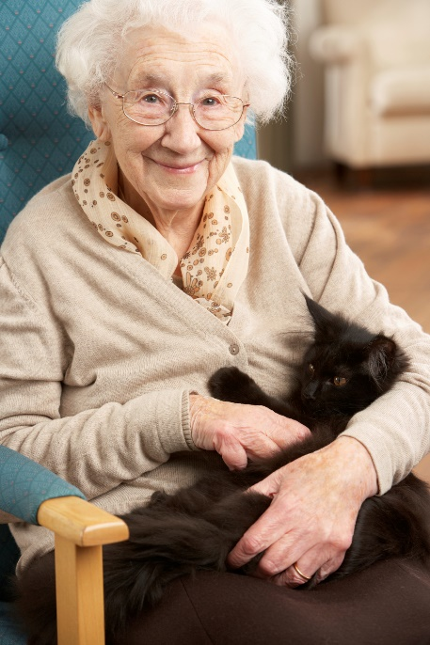
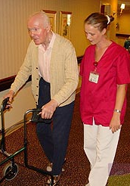
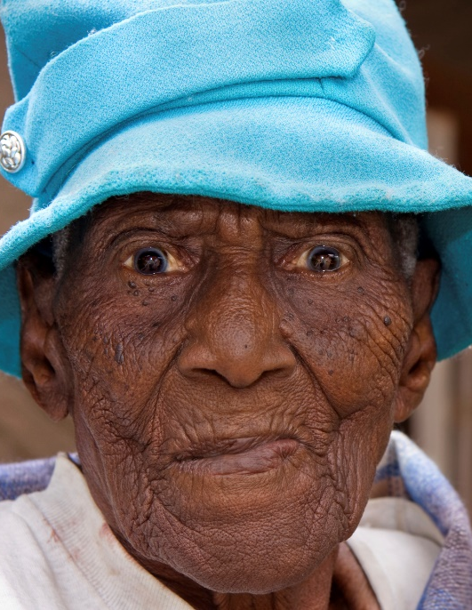
Would you treat?
92 year old HTN Independent T score hip -2.7 | 78 year old Parkinson’s Disease Frail, falling T score hip -1.7 | 85 year old Care home resident Advanced dementia Not ambulating h/o Colles’ fracture 3 years Alendronate
Notes:
Frame discussion around common clinical scenarios
Advanced age but healthy and independent
Younger but with multiple high risk comorbidities and frailty
Severe frailty and dependence but high risk

Slide 6
Higher Absolute Fracture Risk with Age
Adapted from Sambrook et al., Lancet 2006;367:210-8
Notes:
There is strong theoretical rationale for prioritizing osteoporosis care in older vs. younger patients
-exponential increase in fracture risk with age beginning around age 65 women, a little later men
-Risk in 85 yo is 10x that of a 50 yo

Slide 7
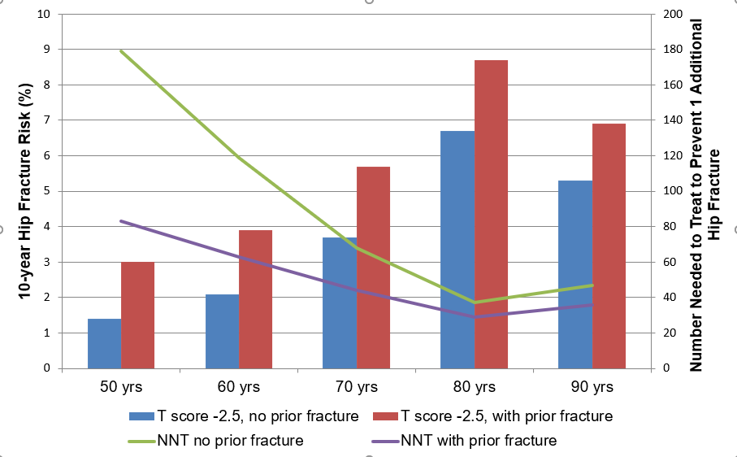
Lower “Number Needed to Treat” with Age
Notes:
That increase in absolute risk with age translates into a substantially lower “number needed to treat” to prevent 1 additional fracture
-The red and blue columns depict the10-year hip fracture risk for a theoretical woman in the U.S. with a T score -2.5, with and without prior fx.
-as we saw on the previous slide it goes up with age until the 9th decade when it decreases a little – this is because the risk of death competes with the risk of fracture, but note that it is still higher than the 70 year olds
The purple and green lines show the NNT with 5 year course of alendronate to prevent 1 additional hip fracture, based on efficacy data from most recent meta-analysis. Green is in people without prior fx, purple with prior fracture
Decreases precipitously from 50-80s, then goes up slightly in 90s due to that competing mortality risk,
BUT still substantially lower than for people in 60s and 70s who we would treat without a second thought
Only need to treat about 40 90 yos, compared to 60-120 60 yos

Slide 8
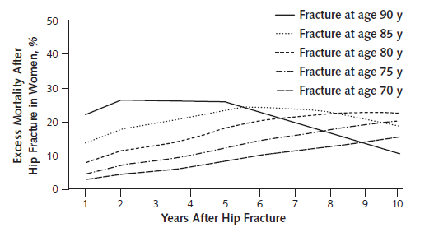
Higher Fracture Morbidity and Mortality with Age
Annals of Internal Medicine, 2010, 152(6):380-90. PMC3010729
Notes:
Another compelling theoretical reason to prioritize treatment in older vs. younger people is that fractures have a greater negative impact with age
-This figure depicts the excess mortality after hip fracture for women in 5 year age increments between age 70 and 90 years
-10 x higher in 90 yo than 70 yo, persists at least 5 years
-We could show similar figures for
-recovery of ambulatory function
-disability
-cardiovascular complications
-quality of life
-

Slide 9
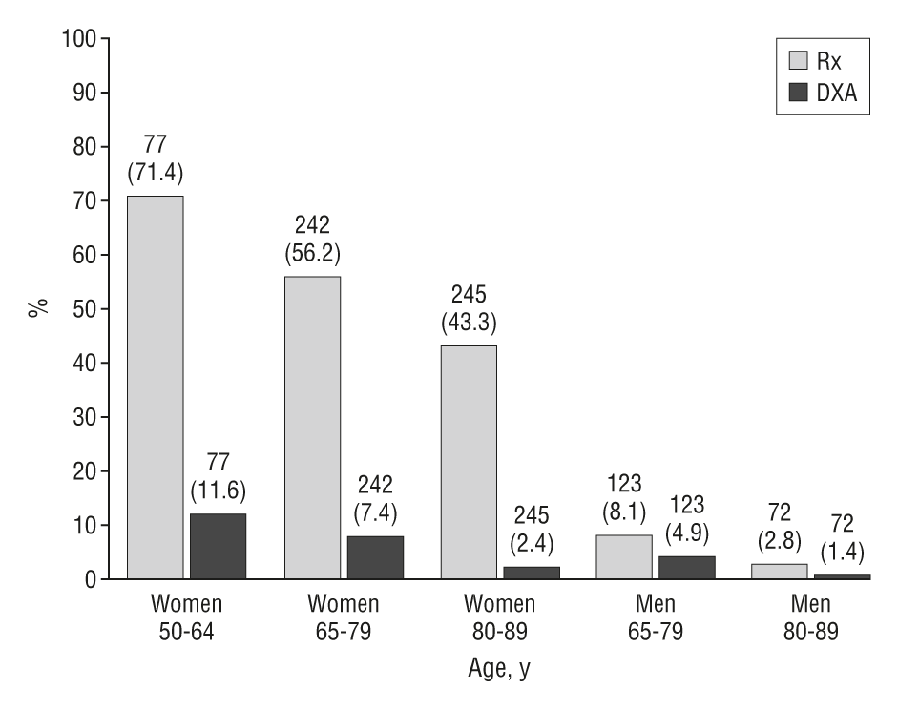
Screening and Treatment Declines with Age
Arch Intern Med. 2003;163(18):2165-2172. doi:10.1001/archinte.163.18.2165
Notes:
So fracture rates, morbidity and mortality all increase with age, and the amount of bang for our buck in treating at a population level is significantly greater in older vs. younger adults
One could argue we should be screening and treating older persons at much higher rates than younger persons
But in fact we observe the opposite. This is older data but sadly the patterns and numbers don’t look very different today.
-substantial declines in screening and treatment, especially in the 8th and 9th decades

Slide 10
Reasons for Low Treatment Late Life
We usually stop preventive care at age 75. They won’t live long enough to benefit
We don’t have good evidence that treatment works for frail, older patients
They have too many other illnesses – it’s not a priority
It’s hard to get a DXA and estimate their fracture risk accurately
Older patients won’t take it
Notes:
Why is this? Our group has done several qualitative studies of patients, families, and healthcare providers to probe for why these smart people are choosing to forgo OP screening and treatment, and these are the most common themes we hear – all very reasonable
So let’s examine each of these themes and see what additional evidence might inform our decisions

Slide 11
Age Related Co-Morbidities
Too many illnesses
Condition | BMD | Falls | Fractures
CKD | Decreased | Increased | Increased
Parkinson’s Disease | Decreased | Increased | Increased
Stroke | Decreased | Increased | Increased
Visual Impairment | None | Increased | Increased
Dementia | Decreased | Increased | Increased
CHF | Decreased | ? | Increased
Depression | Decreased | Increased | Increased
Prostate cancer | Decreased | ? | Increased
Diabetes | Decreased | Increased | Increased
Urinary Incontinence | None | Increased | Increased
Notes:
It is absolutely true that we tend to accumulate multiple comorbidities as we get older
-complicate screening and treatment decisions
-simply take time and attention away from OP management
Short list of common age-related comorbidities
Interestingly, because these share common risk factors and underlying biological mechanisms with each other and geriatric syndromes, most of them are associated with worse BMD, higher risk of falls, and ultimately an even greater fracture risk than in age-matched people without those comorbidities
So I would argue having multiple age-related comorbidities is an even stronger reason to prioritize OP screening and treatment

Slide 12
Common Medications for Older Adults
Too many illnesses
Medication | BMD | Falls | Fractures
SSRIs | Decrease | Increase | Increase
Other psychoactive | ? | Increase | Increase
Opiates | ? Decrease | Increase after dose change | Increase
Cardiovascular | Increase (thiazides) | Increase after dose change | Increase after dose change
PPIs | Decrease | None | Increase
ADT | Decrease | ? | Increase
Cholinesterase inhibitors | ? | ? | Decrease?
Antiepileptics | Some agents decrease | Increased by indication | Some agents increase
GLP-1 Inhibitors | Decrease | ? | ?
Notes:
Similarly, many of the with medications we use to treat those age-related comorbidities have a negative effect on BMD, falls, and fracture rates although their impact is more modest and less consistent across studies.
So while polypharmacy is an important consideration when you are selecting OP treatment as we’ll discuss in a little while, I don’t think it is sufficient reason to forgo treatment

Slide 13
Top 3 Causes Disability in Older Adults
Not a priority
Arthritis and Musculoskeletal Conditions
Dementia
Injurious Falls and Fractures
Lancet. 2024 Dec 7;404(10469):2314-2340. doi: 10.1016/S0140-6736(24)01446-6.
Notes:
It is sometimes helpful to remind our patients and colleagues that injurious falls and fractures consistently rank among the top 3 causes of years lived with disability worldwide for older adults, as well as ranking in the top reasons for ED visits and hospitalizations
Of these top 3 causes, we have much better preventive strategies available for OP than for dementia or OA

Slide 14

Why Include Frail Older Adults in Research?
Limited evidence in old and frail
Highest risk and burden
Currently underrepresented
Need to understand:
  Tolerability, safety, adherence, impact of competing mortality, co-morbidities
https://5tsframework.duke.edu/
Notes:
Let’s move onto the next concern we hear about treating OP in the oldest old – lack of inclusion in the clinical trials used to approve our available treatments
Now, I find it interesting that I rarely hear this concern about other treatments where older adults have been similarly underrepresented in trials, like heart failure or afib management
However, it is absolutely true and something I think our research community needs to address. Colleagues at Duke have developed frameworks and tools to help with recruiting and retaining frail older adults in research
Important that we include them to understand whether there is any difference in tolerability , safety, adherence, or the impact of competing mortality by age or frailty status
Let’s examine the data that we do have available about these issues

Slide 15
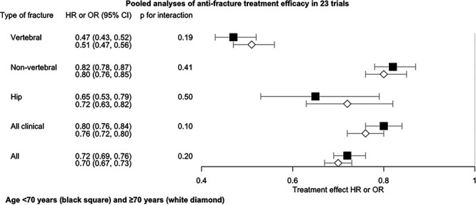
Meta-analysis 23 RCTs <70 vs. >70 years
Limited evidence in old and frail
J Bone Miner Res. 2024 May 24;39(5):544-550. doi: 10.1093/jbmr/zjae040.
Notes:
This is a meta-analysis that looked at treatment efficacy for OP treatments in this case BPs,for those over vs. under age 70, by type of fracture.
Really no signal at all that there is a difference with age, with overlapping confidence intervals for all fracture types
The only significant statistical test for an age interaction was that BMD increases were actually greater in older age group

Slide 16
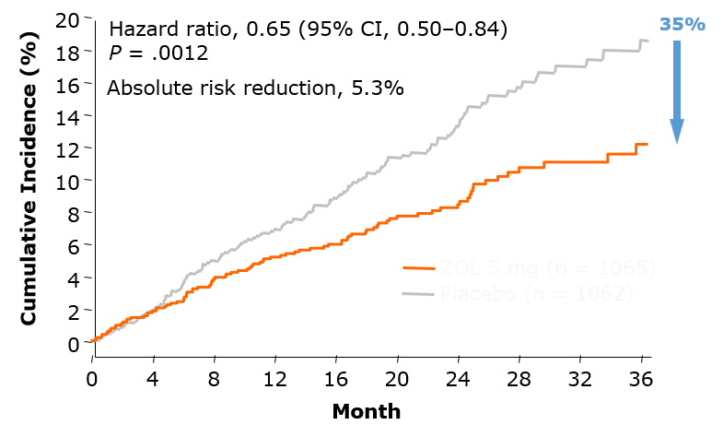
HORIZON-Recurrent Fracture Trial
Limited evidence in old and frail
2127 hip fracture patients
  54% >75 years, 14% >85 years
Annual ZOL 5 mg iv or placebo
3-year outcomes
  35% reduction fractures
  28% reduction mortality
No age interaction
N Engl J Med 2007;357:1799-1809
Notes:
But 70 is still quite young in my line of work, and these trials certainly suffered from healthy volunteer bias
Let’s look at a few studies that did include substantial numbers of people at advanced ages and with high rates of frailty
HORIZON RFT
-more than ½ over age 75 and nearly 15% over age 85
-no exclusions for dementia, NH residence, most comorbidities
-saw no evidence of age interaction for the reduction in fractures or mortality

Slide 17
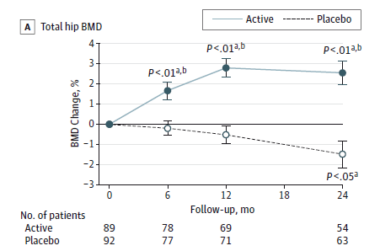
ZEST Trial
Limited evidence in old and frail
Women in LTC facilities
  Mean age 85 years
  Gait speed 0.5 m/s
  >60% Frail
  High ADL dependence
Yearly Zoledronic acid 5 mg iv
Change in BMD
Greenspan SL. JAMA Intern Med. 2015 Apr 13. doi:10.1001/jamainternmed.2015.0747
Notes:
Susan Greenspan has done some really nice trials in frail populations living in long-term care
This is a RCT of ZA given yearly to women in LTC facilities with OP
Mean age 85
Average gait speed – under 1 m/s assoc with increased mort and functional impairment
High proportion frail, ADL dependency
Comparable changes in BMD to those observed in younger, community dwelling women
Not powered for fracture, but again with no signal that there should be a difference in efficacy by frailty status

Slide 18
Guidelines in Oldest Old
Limited evidence in old and frail
“In general, a high level of evidence suggests that bisphosphonates are at least as effective for older people as for younger”
AHRQ Evidence Synthesis
“Frail, multimorbid patients have the highest fracture risk and therefore the most to gain from treatment”
UK NOGG Guidance
18
Hochberg, JBMR 2005;20:971-6; Boonen, JAGS 2006;54:782-9; Age Ageing. 2022 Apr 1;51(4):afac044.
Notes:
And so, the few guidelines that have explicitly addressed the issue have concluded that there is good evidence to suggest that efficacy and safety are preserved in late life, and in some cases emphasized the point that those with frailty and multimorbidity have the most to gain from treatment

Slide 19
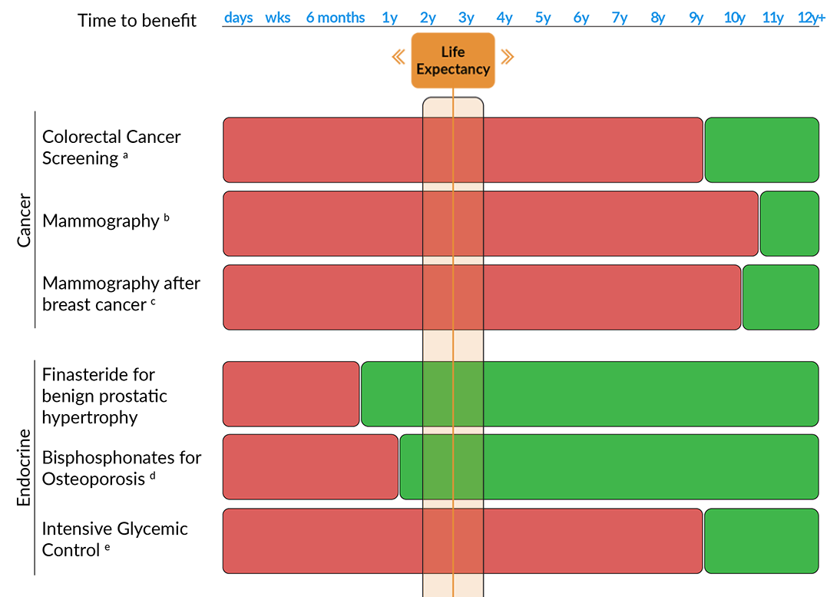
Prevention vs. Life Expectancy
Won’t live long enough to benefit
ePrognosis.com
Notes:
Now let’s turn to the issue of competing mortality risk we started to talk about earlier. It is also absolutely true that we tend to deprioritize many screening and prevention services for older adults, because the time it will take for them to start seeing a benefit exceeds their remaining life expectancy, so they get all the risks and harms without any gain
This figure is from an excellent resource developed by geriatrics colleagues at UCSF called ePrognosis. Allows you to estimate your patient’s life expectancy and compare that to the lag time to benefit for common prevention scenarios
-for this patient with a 3 year life expectancy, it does not make sense send for colonoscopy or mammogram, even if they have had breast cancer
-may make sense to consider finasteride for BPH or treat with BPs for OP

Slide 20
Lag Time to Benefit
Won’t live long enough to benefit
Meta-analysis 10 RCTs Bisphosphonates
To prevent 1 additional non-vertebral fracture
100 women take for 12.4 months
To revent 1 additional hip fracture
200 women take for 20.3 months
Prevent 1 additional vertebral fracture
200 women take for 12.1 months
JAMA Internal Medicine 2022;182;(1):33-41. doi:10.1001/jamainternmed.2021.6745
Notes:
Let’s examine the lag time to benefit a little more carefully by type of fracture and agent
On the left is a quick and dirty figure I put together simply by looking at where the fracture hazard curves clearly diverge from each other in treatment vs. control patients in the pivotal fracture trials.
-typically 6-12 months, sooner for vertebral compared to hip fracture
-perhaps a little earlier for denosumab and romosozumab
Another colleague at UCSF did this a little more scientifically and put some NNT numbers around the issue in a meta-analysis of 10 RCTs of BPs.
We’re looking at a 1-2 year lag time at a population level before we start seeing significant benefits from a prevention strategy, at least for BPs.

Slide 21
Remaining Years of Life Expectancy
Won’t live long enough to benefit
Age (yrs) | 75th percentile Women Men |  | 50th percentile Women Men |  | 25th percentile Women Men
70 | 22.2 | 18.0 | 16.2 | 12.4 | 10.1 | 6.7
75 | 17.9 | 14.2 | 12.8 | 9.3 | 7.2 | 4.9
80 | 13.9 | 10.8 | 9.7 | 6.7 | 4.9 | 3.3
85 | 10.3 | 7.9 | 7.1 | 4.7 | 3.2 | 2.2
90 | 7.4 | 5.8 | 5.1 | 3.2 | 2.0 | 1.5
Notes:
Let’s look at how this tension between life expectancy and lag time to benefit works for the patients in our scenarios
This graph shows the average life expectancy for women and men in the U.S. at 5 year age increments from 70-90
-this is what FRAX uses in adjusting the 10-year fracture probability estimates; for those with <10 year life expectancy it is really a “fracture in the remaining average life expectancy” estimate
But population heterogeneity increases with age, and so there is significant variability around this average
-healthiest 25% likely to live more than the 75th percentile value
-frailest, most multimorbid 25% likely to live less than the 25th percentile value

Slide 22



Our Patients
Won’t live long enough to benefit
Age (yrs) | 75th percentile Women Men |  | 50th percentile Women Men |  | 25th percentile Women Men
70 | 22.2 | 18.0 | 16.2 | 12.4 | 10.1 | 6.7
75 | 17.9 | 14.2 | 12.8 | 9.3 | 7.2 | 4.9
80 | 13.9 | 10.8 | 9.7 | 6.7 | 4.9 | 3.3
85 | 10.3 | 7.9 | 7.1 | 4.7 | 3.2 | 2.2
90 | 7.4 | 5.8 | 5.1 | 3.2 | 2.0 | 1.5
Notes:
So our healthy, independent 92 year old likely has a 6-7 year life expectancy, substantially exceeding that 1-2 year lag time to benefit
Our 78 year old frail and multimorbid gentleman is likely in the 3-5 year range
And our 85 year old very frail nursing home resident is likely to live <3 years

Slide 23
Cost-Effectiveness, Age and
Life Expectancy
Won’t live long enough to benefit
Pham et al. JAGS, 2011 (Sep);59(9):1642-9.
Notes:
Another way to think about the balance between fracture prevention and competing mortality risk at a population level is through cost effectiveness analysis.
Markov analysis of hypothetical cohort of women with OP treated with BP for up to 5 years. We assumed a 6 month lag time to benefit, and identified fracture risk reduction, costs, and impact on quality of life for from meta-analyses in the literature. We calculated the cost per QALY gained for those in the lowest quartile of remaining life expectancy in dark blue, average life expectancy in orange, and highest life expectancy in light blue.
Given the generally accepted threshold of $50,000 per QALY, OP treatment is cost effective for everyone. We found that it was more cost effective to treat even the frailest 90 year olds than it was to treat 60 year olds.
So my rule of thumb is that if a patient has at least 2 years of life expectancy (which is what the women in the white bar are here) , and it makes sense with their goals of care, I consider treatment.

Slide 24
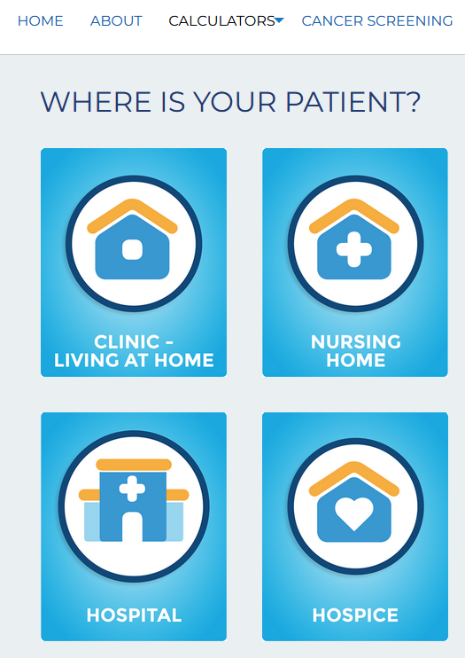
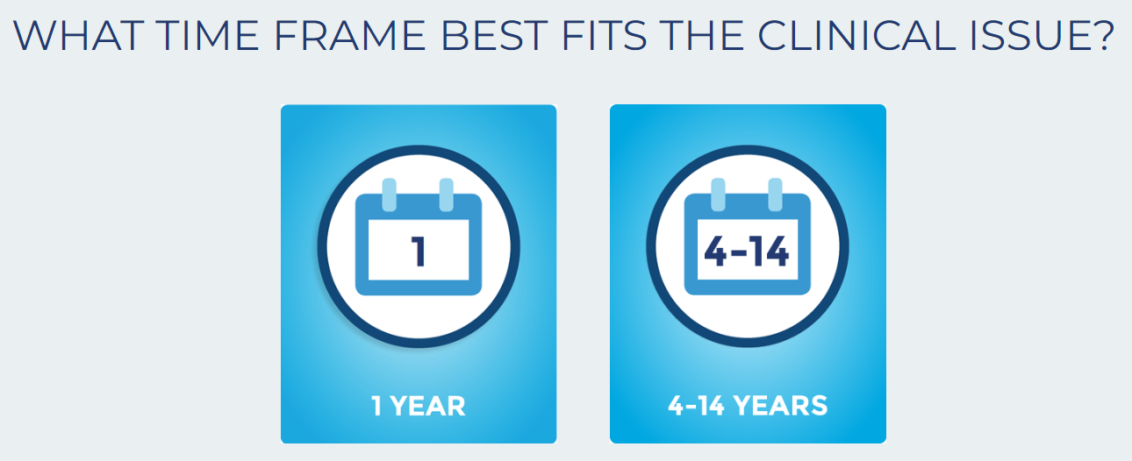
ePrognosis https://eprognosis.ucsf.edu/calculators/
Won’t live long enough to benefit
Notes:
How can you estimate life expectancy in clinical practice?
-keep that life table I just showed you saved on your computer for a quick estimate
-Or you can use a validated tool like those at ePrognosis, derived using population level data for people in various settings (home, NH, hospital)
- Requires more detailed information about comorbidities, functional status

Slide 25
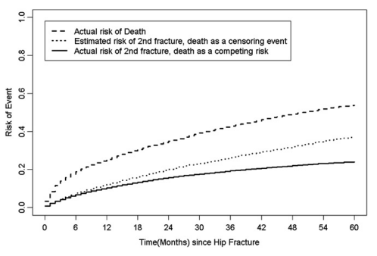
Competing Risk of Death vs.
Secondary Fracture
Won’t live long enough to benefit
30,000+ Medicare Beneficiaries
Risk of death 40% higher than risk of additional fracture
5-year additional fracture risk 13-43%
  Number needed to treat to prevent 1 additional fracture 8-46
JAMDA 11:8; 2010, 584-591,ISSN 1525-8610, https://doi.org/10.1016/j.jamda.2009.12.004.
Notes:
What if our patient has had a recent major OP fracture – we know that this increases both the risk of mortality and the risk of additional fractures – how does this impact the competing risk calculation?
This is data from a study led by Jeff Curtis a few years ago using US Medicare beneficiaries
-indeed, we observed that the risk of death was always higher than the risk of additional fracture in this group, about 40% higher across all groups and time points
- But the 5 year fracture risk was still high enough, 13-43%, that it still made sense to consider treatment in these individuals, with relative low NNT comparable to other prevention strategies we use routinely like statins after heart attack

Slide 26
Selecting Individuals at High Risk
Who to treat?
Adapted from Greenspan et al. JAGS 2012 60:684
Notes:
Once we have determined that the patient’s remaining life expectancy is longer than the 1-2 year lag time to benefit, how do we estimate fracture risk accurately to select those who should be offered treatment? Especially important in populations like NH residents where it is challenging to get a DXA
This study from Susan Greenspan looked at older women living in AL and LTC facilities. All had DXA with Vertebral Fracture Assessment (VFA) and heel US done in a mobile unit, as well as chart review for known clinical fracture and FRAX risk factors. She compared what proportion would be selected for OP treatment based on 6 different selection strategies.
Explain range of results
So what selection strategies should we use?

Slide 27
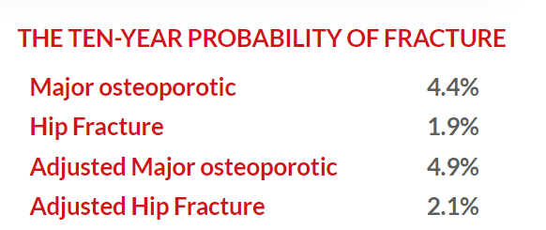
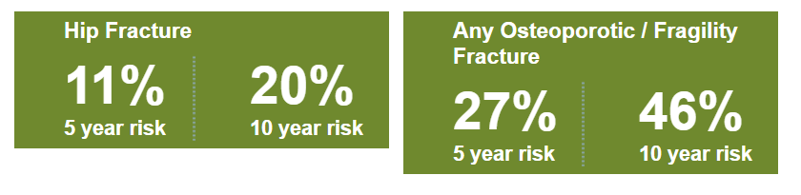
85 yo Black male with Parkinson’s, osteopenia, falls
Who to treat?
FRAX,
FRAX Plus
Garvan
Notes:
Let’s look at fracture risk tools in this population a little more closely. Imagine we have an 85 yo Black US male average height and weight with a T score of -2, no prior fracture or other risk factors captured in FRAX, but 2 falls
-FRAX and FRAX plus give us 10-year fracture probabilities below our current US treatment threshold
-Garvan on the other hand gives us wildly different estimates that would definitely prompt us to encourage treatment
Garvan may overestimate risk by not including
Life expectancy <10 years
Neither model incorporates
Age-related co-morbidities
Functional status, frailty
Environment (community, NH)
Multiple medications
Models useful as a starting point, but need a “geriatric adjustment” . Think of FRAX as the lower bound of my fracture estimate

Slide 28
The “Geriatric Risk Adjustment”
Who to treat?
Condition | Fracture Risk
NH Residence | RR 4-10
Renal Impairment | RR 1.4 for every 10 cc/min decrease GFR
Parkinson’s Disease | RR 2.5
Prostate Cancer | RR 2-4
Stroke | RR 2.5
Cognitive Impairment | RR 1.6-2.5
Vitamin D Deficiency | RR 2.0
28
Looker et al, JBMR 2007; Melton et al, Movement Disorders 2006; Kanis J, Lancet 2002
Notes:
These are the common age-related conditions I use to adjust those FRAX estimates upward
Not as simple as simply multiplying the FRAX estimates by these relative risks, but the magnitude of the RR can give you a sense of how much higher the risk is likely to be – if I have a NH resident I know that FRAX is substantially underestimating their risk, while some of the other comorbidities have a lesser impact

Slide 29
Frailty and Falls/Fractures
Who to treat?
Adapted from Tom SE, et al. Journal of the American Geriatrics Society 2013
Notes:
What about frailty and functional impairment?
Frailty is actually a much more important risk factor for fractures than age – again highlighting the heterogeneity of older adults and the fact that age is just a number
A multinational longitudinal study of nearly 500,000 community dwelling women aged 55 years and over showed that frail and pre-frail status is associated with a substantially higher risk of recurrent falls and fractures, and that the risk did not vary substantially over different age ranges from the 5th through 9th decades.²

Slide 30
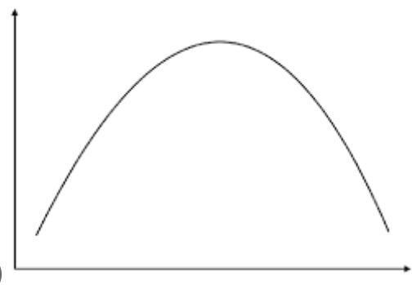
Fracture risk and Functional Status
Who to treat?
Increasing Fall Risk
Declining mobility, competing mortality
Fracture Risk
Level of Functional Impairment
Osteoporosis International, 2003;14:484-489
Notes:
That said, the relationship between frailty, function, and fractures is a little more complicated. We used national nursing home data which includes functional status to predict which people were going to have a hip fracture in the next few years – these are the most frail and vulnerable patients in our population. While most of the risk factors we observed were expected and similar to risk factors in more robust community dwellers, we actually saw a number of fracture risk factors that were reversed from what we expected.
-having urinary incontinence, low vision, and being more dependent for transfers were actually protective for having a future hip fracture, while those receiving PT and OT had a higher risk for fracture.
-What this suggested to us was that among the most frail people, there is a point at which you are requiring so much assistance for your daily activities and your mobility has declined so much that you have less opportunity to fall and fracture. Of course, these individuals also likely have the highest competing mortality rates. This has been borne out by subsequent studies, and so I’d encourage you to think about frailty and functional status as having more of a U shaped curve with fracture risk such that the most frail and dependent start to be relatively protected against fractures

Slide 31
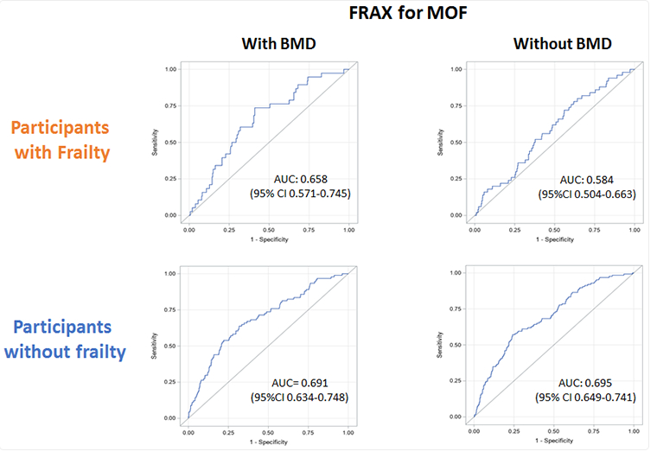
Frailty impact on FRAX Accuracy
Who to treat?
Osteoporos Int. 2024 Feb;35(2):265-275. doi: 10.1007/s00198-023-06950-0. Epub 2023 Oct 24. PMID: 37872347; PMCID: PMC10872348.
Notes:
What is the impact of frailty on the accuracy of FRAX? You can imagine this going both ways – frail more likely to have low BMD and fall, but also more likely to die (competing risk of mortality)
Secondary analysis Framingham heart study 10 year follow up
-compare predictive accuracy FRAX with and without BMD in those with and without frailty
-prediction much better for participants without frailty than those with frailty
-FRAX without BMD did a really poor job in those with frailty with AUC close to 0.5 which is flipping a coin

Slide 32
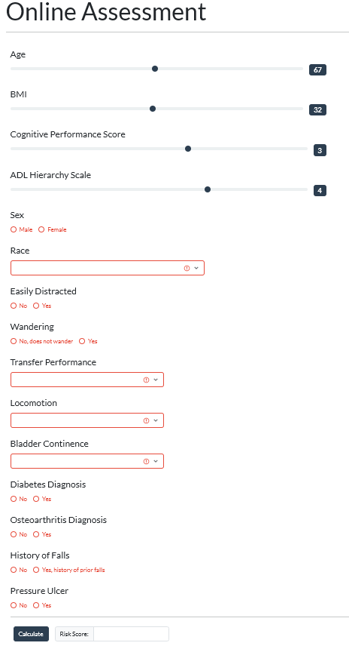

FRaiL Tool
Who to treat?
https://ifar-frail.hsl.harvard.edu/web/evaluation
J Gerontol A Biol Sci Med Sci. 2018 May 9;73(6):763-769.
Notes:
To help clinicians make sense of all this complexity, my colleague Sarah Berry has developed the FRaiL tool specifically for nursing home populations. The model uses routinely collected clinical data from the minimum data set and estimates hip fracture risk in the next 2 years with good calibration.
Available online and may be helpful for decision making among very frail populations

Slide 33

Treatment Decisions Severe Frailty
Who to treat?
Treatment More Appropriate
High fracture risk (FRAX, FRAiL, steroids, etc.)
>2 year life expectancy
Treatment Less Appropriate
Hospice or palliative care
Dysphagia
Ambulatory or Transfer Independent
Non-ambulatory
Fully dependent ADLs
Unable to sit upright
Niznik et al. Journal of the American Medical Directors Association, Volume 22, Issue 1, 2021, Pages 28-35.e3, ISSN 1525-8610
Notes:
While no clinical practice guidelines that I am aware of clearly address the issue of treating very severely frail populations, one of my mentees Josh Niznik did some very nice work using qualitative data and expert panel consensus to delineate factors we can use to help determine whether treatment is more or less appropriate.
Applying this to our 3rd patient, she certainly has high fracture risk but has a number of factors that would render initiating OP treatment if she was treatment naiive

Slide 34
Patient, Family and Staff Interviews
Older patients won’t take it
Initial perception
After data
Key concerns
“Those administration requirements are cruel”
“I’m not taking more medicines unless you take some away”
“How will we know when to stop?
“Do they really need it at their age?”
“Doesn’t it have a lot of side effects?”
“That sounds really good, I would definitely consider it”
Notes:
Finally, what about the common perception that older adults aren’t interested in and won’t take or adhere to OP medications.
-lots of data that I won’t review today that in general, older adults are more adherent to therapies for chronic medical conditions compared to younger people.
-I do want to share some qualitative results from interviews we completed with older patients, family caregivers, and nursing home staff.
-Their initial perceptions when asked about how they would make these decisions mirrored some of the issues we have already talked through
-However, after a brief review of data about the risks and benefits, most actually expressed willingness to consider treatment or at least hear more. Not surprising since most older adults prioritize maintaining function and independence, and nearly everyone has seen the devastating impact fractures can have
-But key concerns about treatment remain. We need to address these as part of their overall treatment plan

Slide 35
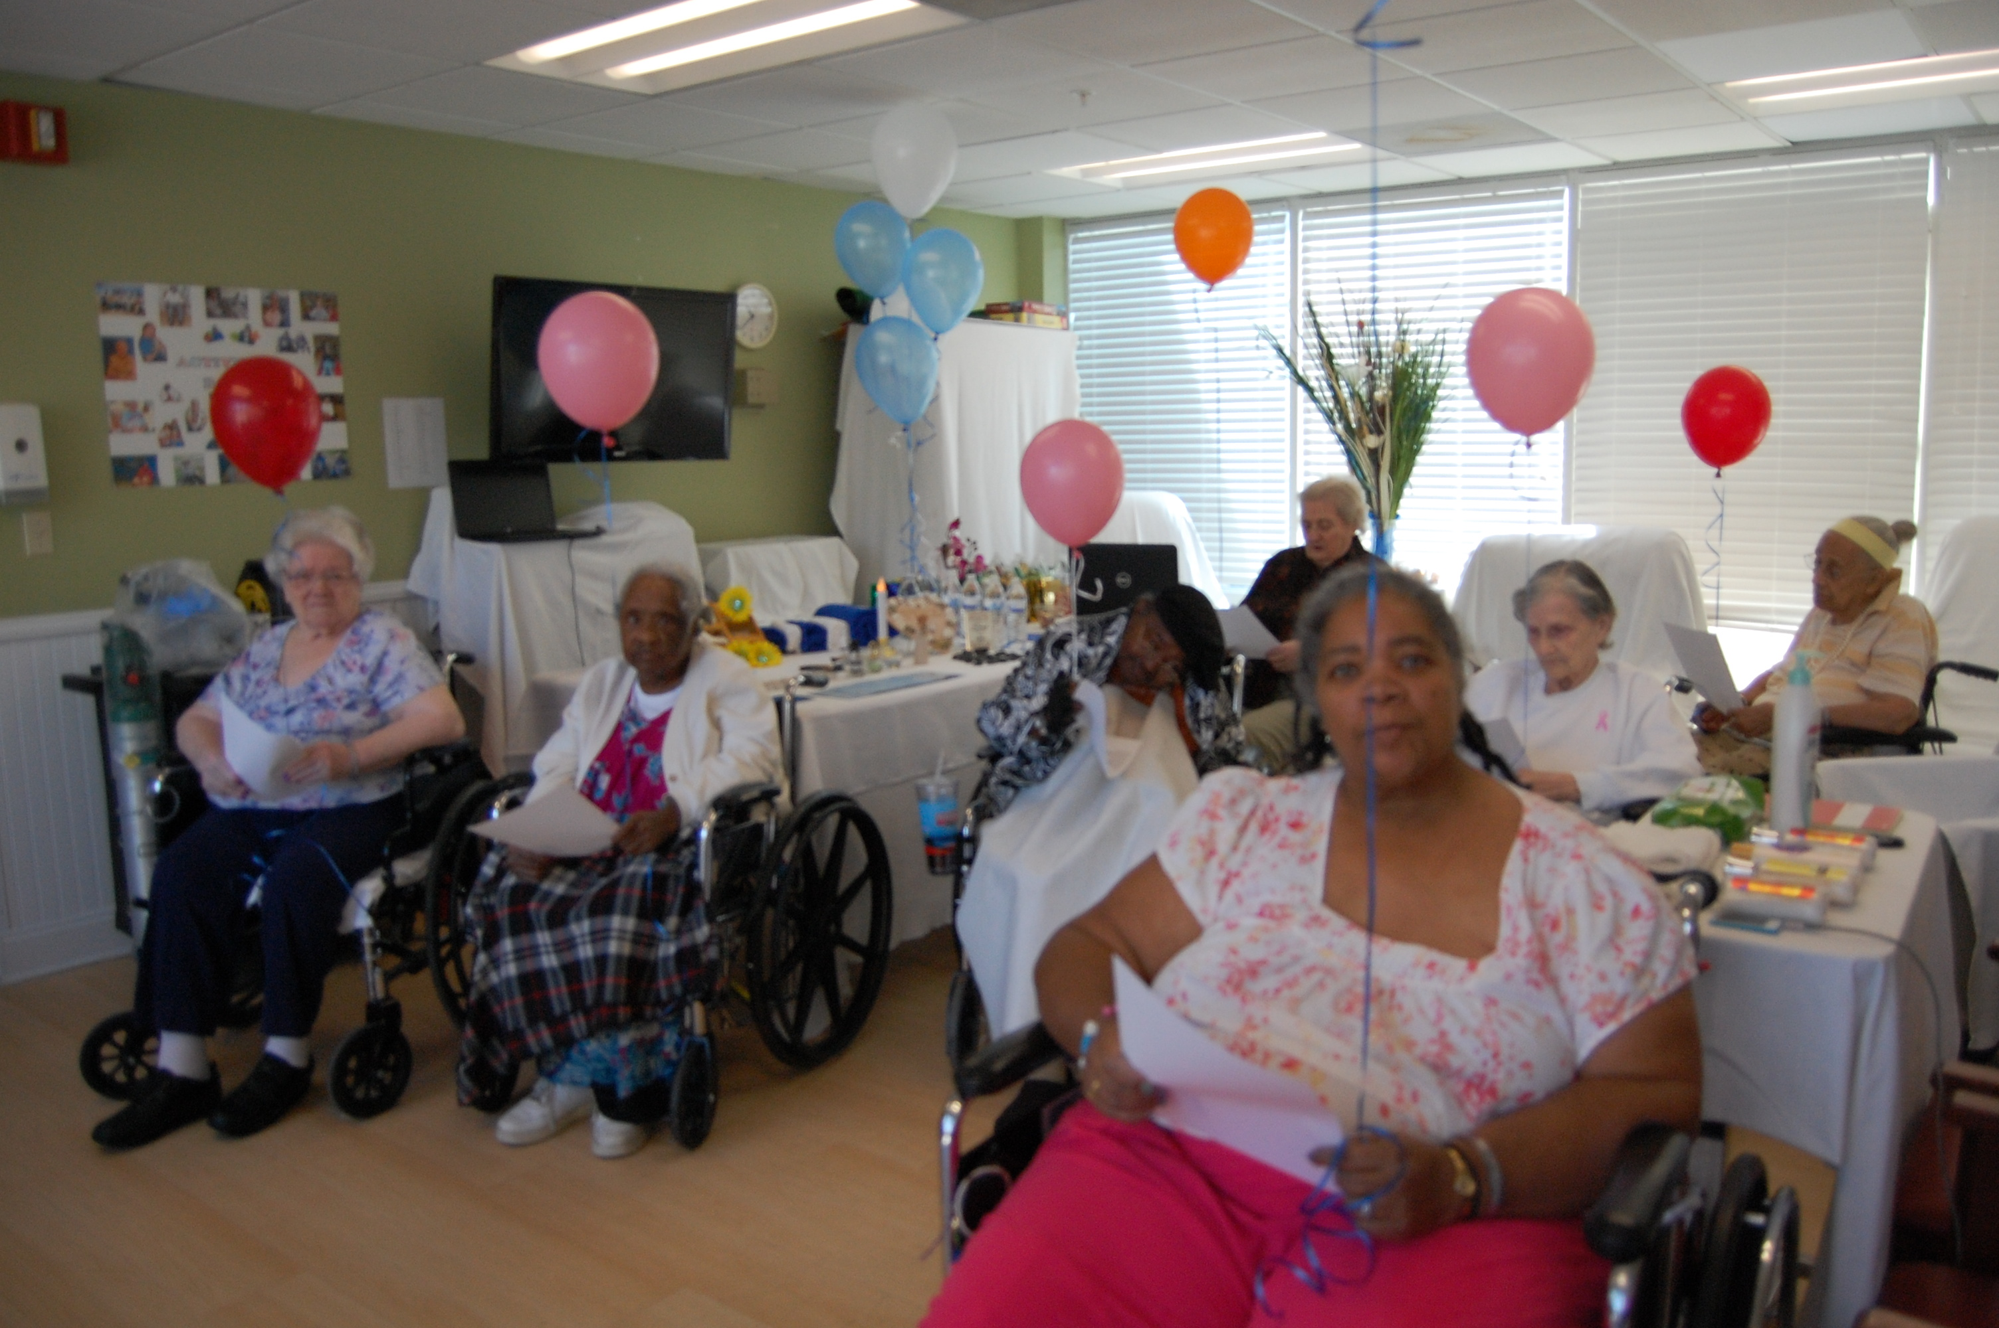
Practical Ideas to Address Concerns
Older patients won’t take it
Alendronate “spa day”
Yearly and twice-yearly options
Deprescribe fall-related medications when prescribing new medications
Plan treatment duration and when to stop
Notes:
Here are some practical ideas to address some of those concerns.
-To deal with the requirement for fasting and sitting upright after oral BPs, one of the nursing homes I work with initiated a “spa day” once a week

Slide 36

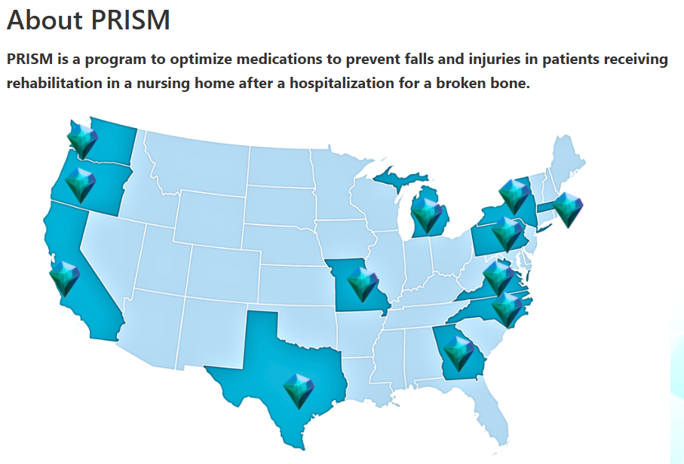
Matters Most
Older patients won’t take it
“Can you tell me what matters most to you as you recover from your fracture?”
Tell me more about what you mean by that
What are some of the reasons why __ is important to you?
Notes:
It is also critical to make sure we sure we are aligning their OP care plans to the individual’s goals and priorities. Given the heterogeneity of the population, as you might imagine that what matters most to older adults also varies widely.
We are conducting a pragmatic cluster randomized trial in >3000 patients with recent OP fx receiving post acute care in 42 SNFS across the country. A remote nurse specialist reviews the SNF EHR, talks with patients and their families over the phone, and then provides a MOP to the SNF provider, PCP, and patient with recommendations for OP treatment, deprescribing FRIDs, or both. Ultimately we will compare subsequent injurious fall rates and PROs between these groups and in patients in control facilities.
In the first telephone call, the nurses ask the patients or their representative what matters most to them during their recovery, using this information to ensure the MOPs are aligned with patient goals.

Slide 37
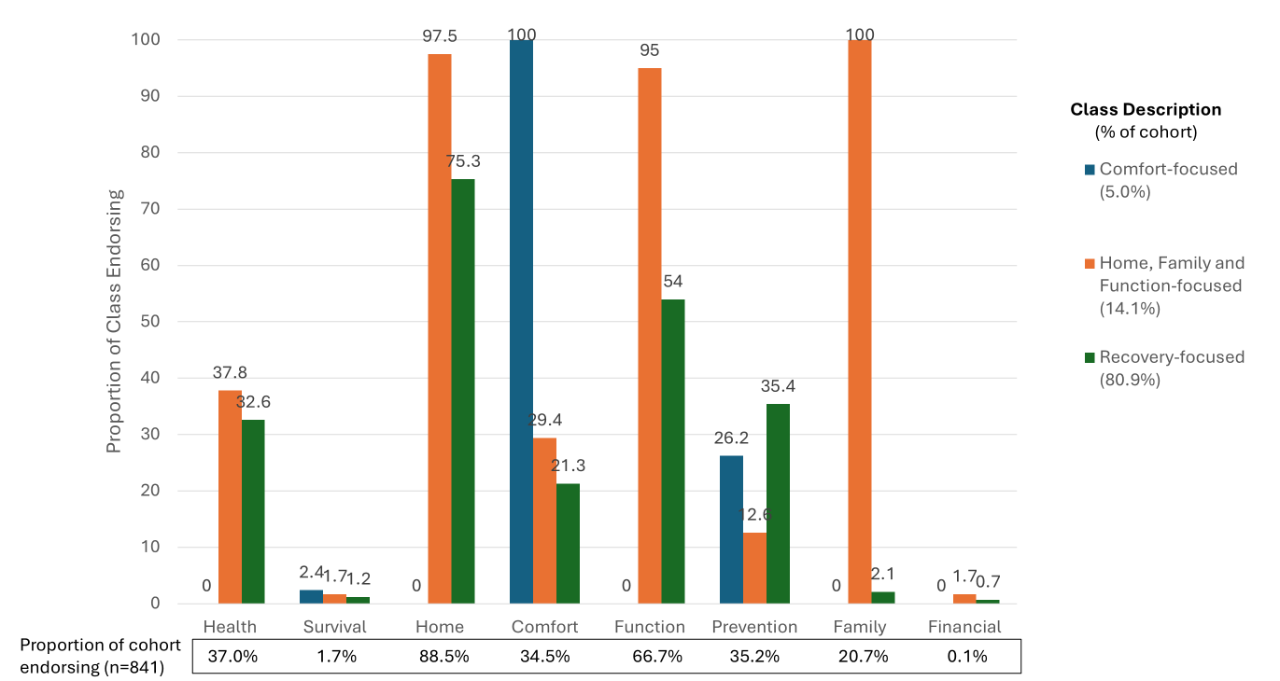
Matters Most
Older patients won’t take it
Notes:
We analyzed the responses from the first 1000 patients in the trial, using LCA to identify groups of patients with common responses. Patients could mention more than 1 goal.
Small group in dark blue 5% were really focused primarily on comfort - note that this number is likely higher in practice since we have selection bias at play in our sample
A second group in orange 14% really prioritized being at home with family and able to function as independently as possible
The largest group in green were really focused on general health and recovery
Note that a substantial proportion of all 3 groups, including the comfort focused individuals, prioritized preventing another fall or fracture, underscoring what a significant impact they have on quality of life

Slide 38

Matters Most – Practice Implications
Older patients won’t take it
“Recovery Focused” → rehabilitation, nutrition, exercise, health promotion
“Home and Function Focused” → in-home programs, family engagement
“Comfort Focused” → manage pain and symptoms
Many (but not all) prioritize fracture prevention across groups
  Align discussion about OP treatment with their goals
Notes:
So how can we tailor or treatment plans based on knowing what matters most to our patients

Slide 39

When to Stop Osteoporosis Treatment
Overtreatment
14% Patients admitted to hospice
20% Nursing Home Residents with Advanced Dementia
Undertreatment
<1/3 Screened within 2 years prior to fragility fracture
<20% treated after fracture
This Photo by Unknown Author is licensed under CC BY-NC
J Gen Intern Med. 2019 Oct;34(10):2029-2037. JB JS Open Access. 2021 Jun 14;6(2):e20.00142.
Notes:
We have been talking about when to consider starting OP treatment for patients with advanced age and frailty, but how do we know when it is time to consider stopping treatment.
Of course we all recognize the major issue of undertreatment, but there is also evidence of overtreatment as well

Slide 40
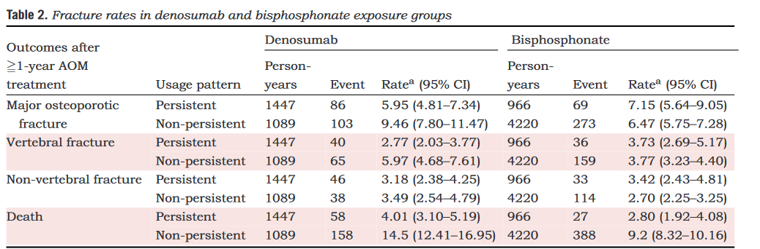
Offset effects
J Intern Med. 2021 Dec;290(6):1194-1205.
Notes:
And it’s important to remember bisphosphonates have prolonged action in bone for up to 3 years after we stop them such that much of their fracture prevention benefit remains
-here is some real world administrative data among BP users for at least 1 year comparing rates of various fracture types among those who continued vs. those who stopped treatment, and you can see that they are not significantly different
-of course that is not the case with other medication classes, and in particular denosumab shows significant offset effects with a rapid increase in fracture risk

Slide 41
My Approach in Older and Frailer Patients
Estimate Life expectancy
Deprescribing Plan
Estimate fracture Risk
Matters Most
Consider treating if > 2 years
Fall prevention for everyone
Prior fracture=high
DXA if feasible
FRAX “geriatric adjustment” or FRaiL
Align fracture prevention to goals
Address practical concerns
Not ambulatory
Palliative care
Completed 3-5 year course and life expectancy <3 years
Notes:
So to summarize the general approach we have been discussing for our oldest old and frailest patients, the first step is to first estimate remaining life expectancy using life tables or a tool like ePrognosis. I consider treatment if they have at least 2 years. Regardless, everyone should have fall prevention prioritized.
Next I estimate their fracture risk. If they have a prior MOF, they are at high risk and DXA is very unlikely to change my decision making. For those without prior fracture I will try to get a DXA if feasible given that FRAX BMI is not terribly accurate in frail older adults, but regardless of whether I have FRAX with BMI or BMD I will always do a geriatric adjustment for comorbidities that I know impact fracture risk
Then I spend a few minutes understanding what matters most to the patient, and try to align the treatment plan to those goals, addressing their practical concerns about administration requirements and polypharmacy
Finally, I make sure we have a clear plan for when to stop therapy, especially if they are prescribed BPs. Typically I recommend we continue until they are no longer ambulatory, transitioning to palliative care, or have completed a 3-5 year course and now have a life expectancy of < 3years.

Slide 42
Would you treat?
92 year old HTN Independent T score hip -2.7 | 78 year old Parkinson’s Disease Frail, falling T score hip -1.7 | 85 year old Care home resident Advanced dementia Not ambulating h/o Colles’ fracture 3 years Alendronate
Notes:
So let’s bring this back to the patients we started with
-I’d encourage the healthy independent 92 year old to initiate treatment given her high fracture risk and >5 year life expectancy
-FRAX will significantly underestimate fracture risk in our 78 year old with osteopenia, frailty, and multimorbidity. His life expectancy is 3-5 years, which exceeds our 2 year minimum. So I would do shared decision making about the risks and benefits of starting treatment, encouraging treatment if his primary goals are to avoid NH placement or maintain independence knowing that a major fracture is likely to be devastating in this individual
-Finally, our 85 year old nursing home resident is now on the decreasing risk side of the frailty curve, she has completed 3 years of treatment and will likely have fracture protection benefit for most or all of her remaining 2-3 year life expectancy, and I would discuss deprescribing alendronate in this individual

Slide 43

Questions
Thank you for caring for these vulnerable patients and their families
Cathleen.colonemeric@duke.edu

Slide 44



