Slide 1
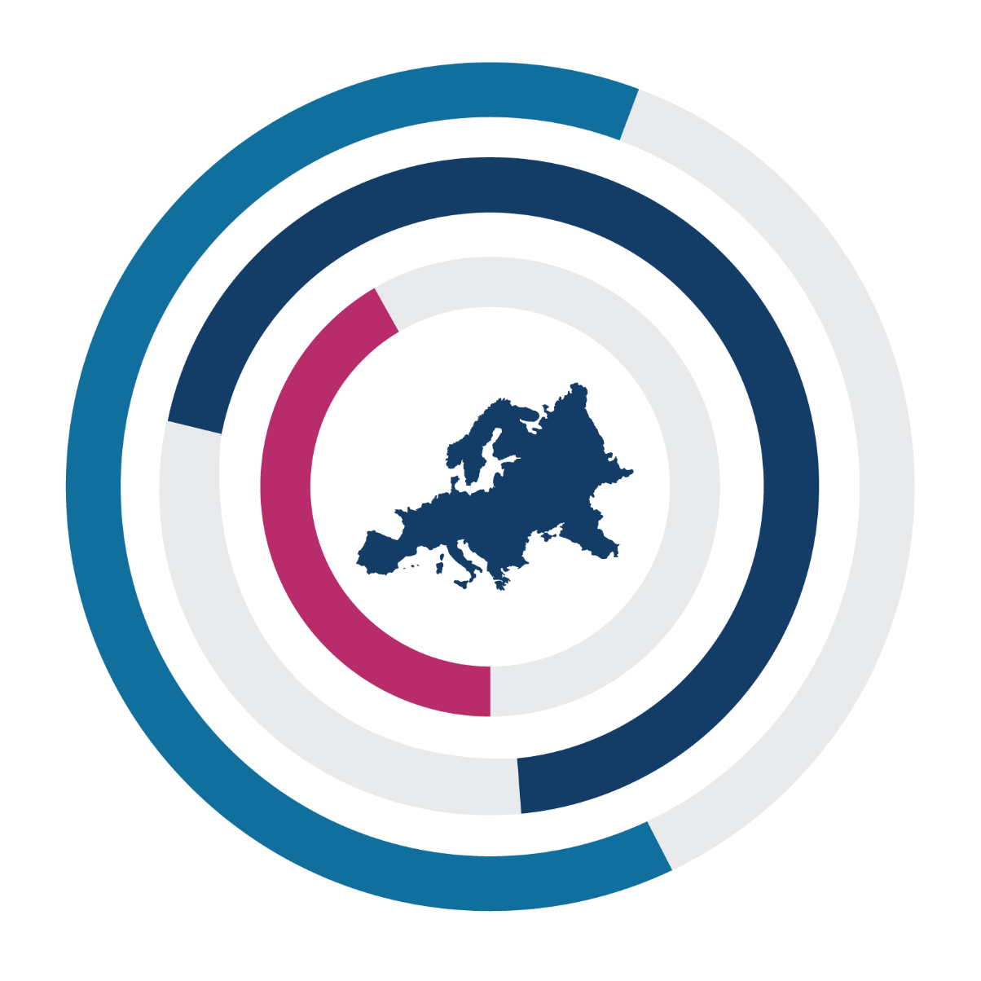
SCOPE 2021
A New Scorecard for Osteoporosis
In Europe
Sweden
If sharing data or information from this slide deck, please reference as: Kanis JA, et al. SCOPE 2021: a new scorecard for osteoporosis in Europe, Arch Osteoporos 2021
Data from SCOPE 2021 resources, International Osteoporosis Foundation
https://www.osteoporosis.foundation/scope-2021

Slide 2
A NEW SCORECARD FOR OSTEOPOROSIS IN EU 27+2
REVEALS BURDEN OF DISEASE, GAPS, AND INEQUALITIES IN OSTEOPOROSIS & FRACTURE PREVENTION AND CARE
SWEDEN
583,000
BURDEN OF DISEASE
124,000
CHANGE IN COST PER INDIVIDUAL
INDIVIDUALS WITH OSTEOPOROSIS IN 2019
77.6%
€229.1
2019
NEW FRAGILITY FRACTURES IN 2019
WOMEN
+30%
22.4%
338
FRACTURES
PER DAY
14
FRACTURES
PER HOUR
MEN
€176.6
2010
5.6% OF THE TOTAL POPULATION
€2.3
SPENT IN 2019
PROJECTED INCREASE IN THE NUMBER OF
FRAGILITY FRACTURES
161,000
124,000
2034
€848 €1.4 €45
BILLION
MILLION
LONG-TERM DISABILITY COSTS
BILLION MILLION
2019
DIRECT COST OF INCIDENT FRACTURES
PHARMACOLOGICAL INTERVENTION
+30.1%
HUGE COST BURDEN FOR OSTEOPOROSIS-RELATED HEALTHCARE
READ SCOPE 2021 AT
https://www.osteoporosis.foundation/scope-2021
Reference
Willers C et al. Osteoporosis in Europe: A Compendium of country-specific reports. Arch Osteoporosis 2022

Slide 3
128,000
A NEW SCORECARD FOR OSTEOPOROSIS IN EU 27+2
REVEALS BURDEN OF DISEASE, GAPS, AND INEQUALITIES IN OSTEOPOROSIS & FRACTURE PREVENTION AND CARE
SWEDEN
SERVICE PROVISION & UPTAKE
261,000
WOMEN REMAIN
UNTREATED
FOR OSTEOPOROSIS
100% 7.4
WOMEN TREATED
FOR OSTEOPOROSIS
REIMBURSEMENT OF OSTEOPOROSIS MEDICATIONS
AVAILABLE DXA UNITS/MILLION INHABITANTS
5306
€85
FRAX® SESSIONS/ MILLION PEOPLE/YEAR
DXA COST
389,000
WOMEN ELIGIBLE FOR OSTEOPOROSIS TREATMENT
67%
YES
25-50%
FRAX® RISK ASSESSMENT MODEL IS AVAILABLE
OF HOSPITALS HAVING FRACTURE LIAISON SERVICES
TREATMENT GAP
POLICY FRAMEWORK
SCORECARD
Burden of Disease
Hip Fracture Risk
Fracture Risk
Lifetime Risk
FRAX® Risk
Fracture Projections
Policy Framework
Quality of Data
National Health Priority
Care Pathway
Specialist Training
Society Support
Service Provision
Treatment
Availability of DXA
Access to DXA
Risk Models
Guideline Quality
Liaison Service
Quality Indicators
YES
NO
YES
OTHER SPECIALTIES INVOLVED IN OSTEOPOROSIS CARE
Service Uptake
FRAX® Uptake
Treatment Gap
Δ Treatment Gap
Waiting Time for Hip Fracture Surgery
ESTABLISHED NATIONAL FRACTURE REGISTRIES
OSTEOPOROSIS RECOGNISED AS A
SPECIALTY
OSTEOPOROSIS PRIMARILY MANAGED IN PRIMARY CARE
ORTHOPAEDICS ENDOCRINOLOGY GERIATRICS
The elements of each domain in each country were scored and coded using a traffic
light system (red, orange, green) and used to synthesise a scorecard.
READ SCOPE 2021 AT
https://www.osteoporosis.foundation/scope-2021
Reference
Willers C et al. Osteoporosis in Europe: A Compendium of country-specific reports. Arch Osteoporosis 2022

